Slide 1

WAPRO Conference - Spring 2023
Legal Update

Slide 2
The case law discussion includes decisions issued from October 20, 2022 through May 12, 2023.
Several unpublished appellate decisions are summarized for this presentation. While they may not be citied as precedent they are nonetheless instructive.
DISCLAIMER
This presentation is educational only and is not legal advice or a legal opinion. The PRA changes over time. Later court decisions or changes in statutes can impact these decisions and an agency’s obligations.

Slide 3
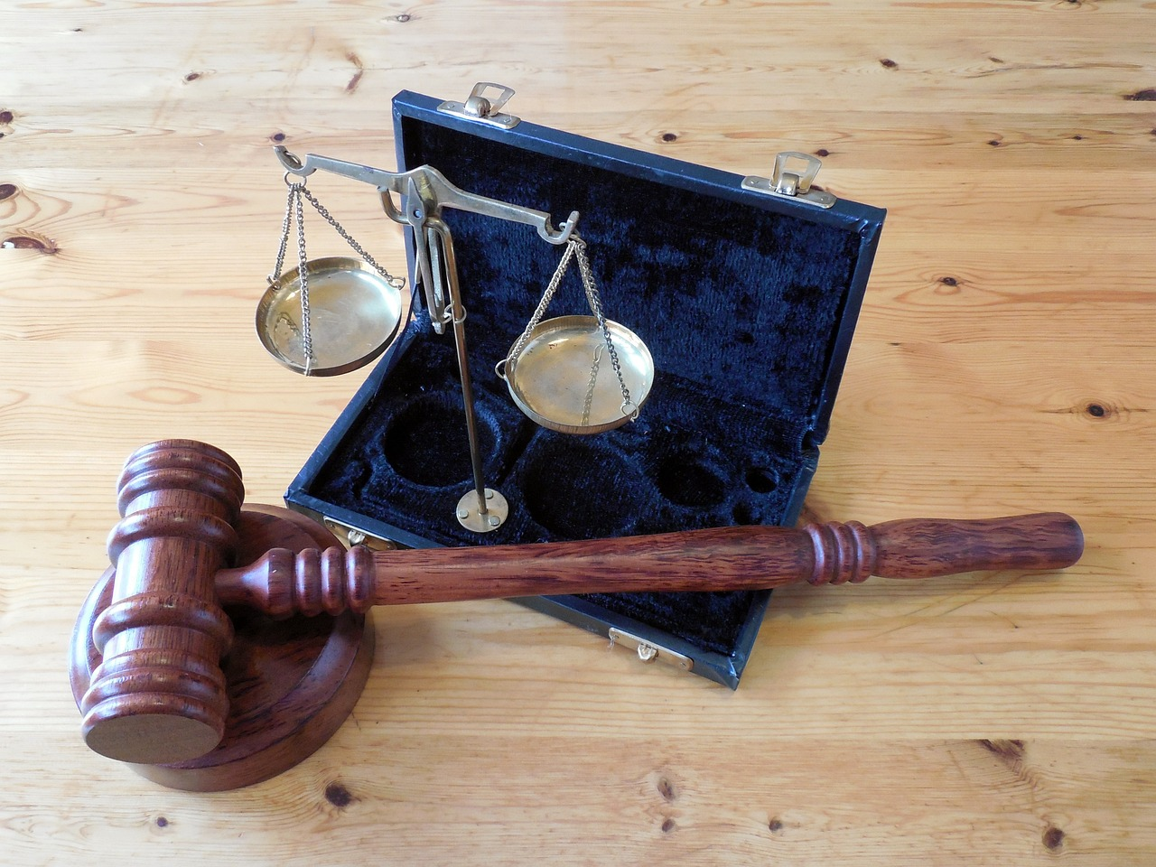
Court Decisions

Slide 4
Sullivan v. University of Washington
1 of 2
60 F.4th 574 (2023)
District Court
The UW, as required by the Animal Welfare Act, appoints a committee to assess animal care and treatment practices as required in experimental research facilities. Some committee members participate anonymously because of personal, family and pet safety concerns. PETA requested committee appointment letters under the PRA. UW provided 3rd party notice of intended records release to the committee members. They sought to enjoin release as a violation of US and State Constitutional rights affiliation, association and expression. The District Court granted a preliminary injunction. PETA appealed.
Application Procedure Records Exemptions Penalties Constitutional

Slide 5
Sullivan v. University of Washington
2 of 2
60 F.4th 574 (2023)
9th Circuit Court of Appeals
The US Constitution’s First Amendment protects the right of those who join together to advance shared beliefs, goals, and ideas, which, if pursued individually, would be protected by the First Amendment. This may be infringed by compelled “disclosure of the fact of membership in a group seeking anonymity. The letters of appointment exist only because the Committee members appointment, not to enhance effective advocacy of their views or lawful private interests, but rather to fulfill federal requirements.
Application Procedure Records Exemptions Penalties Constitutional

Slide 6
Herrick v. DSHS
1 of 1
Unpublished (February 22, 2023)
Trial Court
On remand from Herrick v. Dep’t Soc. And Health Services, No. 37362-2 (unpublished) (2020), through a motion to show cause, DSHS established it does not maintain individual mail logs and the production of general mail log contained information requester sought. Trial court ordered $1 a day penalty for improperly redacted photograph.
Court of Appeals
Agencies may make motions to show cause in PRA actions. DSHS is not obligated to create an individual mail log. Production of general mail log contained information that requester sought. No abuse of discretion in ordering total penalty of $636. Prevailing requesters are entitled to award of costs and trial court did not award costs. This was an error..
Application Procedure Records Exemptions Penalties Constitutional

Slide 7
Blackburn v. State, DSHS
1 of 2
Unpublished (February 9, 2023)
Trial Court
DSHS’s pursued administrative child support against Blackburn (BB) who responded with legal action against DSHS. On June 8, 2018, BB requested records “that concerned her” from DSHS. 60 days later DSHS produced 437 pages, some with redactions, and closed the request. On January 11, 2019, BB again requests records. DSHS provided records 12 days later, with clarification of the request, and closed the request. July 2, 2019, BB made a third request directly to Western State Hospital. Through a conversation with BB on August 30, 2019, DSHS learned BB intended to request a broader scope of records for the 2nd request than in DSHS’s clarification. DSHS reopened the second request with a final installment produced August 26, 2020. BB filed suit over the second request on September 5, 2019.
Application Procedure Records Exemptions Penalties Constitutional

Slide 8
Blackburn v. State, DSHS
2 of 2
Unpublished (February 9, 2023)
Court of Appeals
Denial of a requested record is a prerequisite for filing an action for judicial review of an agency decision under the PRA. Only after an agency has taken final action, or inaction, indicating the nonproduction of responsive records is a PRA suit “ripe.” DSHS took no final action while it continued to provide responsive records in installments.
Application Procedure Records Exemptions Penalties Constitutional

Slide 9
Cousins v. State, DOC
1 of 1
__ Wn. App.2d __, 523 P.3d 884 (2023)
Trial Court
Department produced 7 installments of records and closed records request in January 2019. In 2019, requester communicated several times with DOC alleging missing records. DOC states the request is closed. In July 2020, requester again states there are more records. DOC reopens the request and produces 10 additional installments. Requester files lawsuit in January 2021.
Court of Appeals
DOC’s January 2019 email to requester stating that the PRA was closed was a final, definitive response that started the one year PRA statute of limitations. Requester did not file her PRA action until January 2021, almost a year after the statute of limitations expired. Under Belenski and Dotson, the fact that DOC subsequently produced additional records did not restart the statute of limitations.
Application Procedure Records Exemptions Penalties Constitutional

Slide 10
O’Dea v. City of Tacoma
1 of 2
Unpublished (January 17, 2023)
Trial Court
Requester made a records request to the City for records related to a shooting investigation. Requester files a lawsuit. The final installment of records produced occurred on October 2, 2018. In response to the trial court order finding PRA violation and ordering any additional records to be produced within 30 days, the City declares that to best of its knowledge the City has produced all records. Tacoma appealed the final judgment and Court issues O’Dea v. City of Tacoma, 19 Wn. App. 2d 67, 493 P.3d 1245 (2021). On September 30, 2019, during discovery in wrongful termination case City produces records that requester believes is responsive to the request. September 29, 2020, requester files lawsuit alleging failure to produce records pursuant to trial court order in O’Dea I and alleges “fraud on the court” regarding declaration.
Application Procedure Records Exemptions Penalties Constitutional

Slide 11
O’Dea v. City of Tacoma
2 of 2
Unpublished (January 17, 2023)
Court of Appeals
The PRA statute of limitations is 1 year. Subsequent productions of records does not modify the date of the final definitive agency response. Requester argues equitable tolling. Because the court does not know whether the subsequent record produced in discovery is actually responsive, Court cannot conduct equitable tolling analysis or “fraudulent assurances” analysis. Equitable tolling analysis is fact specific (though court notes equitable tolling is sparingly applied).
Application Procedure Records Exemptions Penalties Constitutional

Slide 12
Conklin v. UW
1 of 2
Unpublished (January 3, 2023)
Trial Court
Conklin was an osteopathic surgeon who applied for, but was not accepted to, the UW’s congenital cardiac surgery fellowship program. Over a period of about two years, he and his attorneys submitted four separate records requests. The first request was a very broad request; one of the broadest the assigned PRO had every managed. The others were also substantial. In addition the PRA office was also responding to hundreds of other requests.
Application Procedure Records Exemptions Penalties Constitutional

Slide 13
Conklin v. UW
2 of 2
Unpublished (January 3, 2023)
Court of Appeals
The estimates of time, assessed by a forward looking evaluation at the time of the request, was reasonable. An agency must respond promptly to a public records request judged by (a) UW’s thoroughness in responding to the request, (b) UW’s demonstration it was diligently working on the requests, (E.g. while 307 and 282 days between installments for one of the requests is a long wait, it was a very broad and complex request, with tens of thousands of documents to review, requiring large exemption logs), and (c) the PRO’s other requests. UW’s records search for the second request was not reasonable, it failed to search the director’s email for contracts. Whether requested in-camera review is needed to evaluate applicability of an exemption is determined by: “(1) judicial economy, (2) the conclusory nature of the agency affidavits, (3) bad faith on the part of the agency, (4) disputes concerning the contents of the documents, (5) whether the agency requests an in camera inspection, and (6) the strong public interest in disclosure. Remanded on this issue and for penalty determination.
Application Procedure Records Exemptions Penalties Constitutional

Slide 14
Beidler v. Snohomish County
1 of 2
Unpublished (May 8, 2023)
Trial Court
On March 12, 2021, Beidler requested primarily records relating to the County’s Driving Review Board but also litigation and maintenance records from other departments, and records related to collisions and injuries. The county complied over 6300 pages of records and other media files of potentially responsive to the request. It produced records in seven installments between May 4 and December 8, 2021, producing 824 pages and other media files actually responsive. Beidler sent a demand letter to the city on December 21, 2021 seeking remaining records and attorney fees. Between January 13 and June 10, 2022 the County provided 7 more installments of 3,564 pages along with other media files. March 9, 2022 Beidler files suit.
Application Procedure Records Exemptions Penalties Constitutional

Slide 15
Beidler v. Snohomish County
1 of 2
Unpublished (May 8, 2023)
Court of Appeals
COA affirms Trial court’s grant of summary judgment to the County. Agencies must disclose records in a timely fashion based on whether the agency’s response was thorough and diligent. The County provided its initial response within 5 business days as required. Considering the size of the request and the complexity of the review process, providing records in installments was not unreasonable. Unlike Cantu, here the county responded within 5 business day, provided the first installment as indicated, provided installments every four to six weeks, provided accurate information on its ongoing installment estimates, and unrebutted evidence of its efforts to satisfy the request. Beidler’s claim that the County filed to allocate sufficient resources failed, no unreasonable delay.
Application Procedure Records Exemptions Penalties Constitutional

Slide 16
Worthington v. Washington State Legislature
1 of 2
Unpublished (October 25, 2022)
Trial Court
Requester sought records from Senator Hasegawa, the 2016 House Rules committee and aides regarding a communication from Joy Beckerman on a specified date and time. Each chamber produced some records, but none from the specified date/time were located. The Senate informed requester that Senator Hasegawa did not have the same cell phone that he did in 2016 and therefore records from that phone no longer existed and could not be searched. Requester filed a lawsuit alleging improper destruction of records and inadequate search.
Application Procedural Records Exemptions Penalties Constitutionality

Slide 17
Worthington v. Washington State Legislature
2 of 2
Unpublished (October 25, 2022)
Court of Appeals
Motion to dismiss regarding Senator Hasegawa’s phone records affirmed. Senate established and Worthington failed to refute that cell phone records did not exist at the time of the request and therefore were not destroyed. Senate was not obligated to obtain phone records from service provider. Centralized email/calendar/voicemail/text message searches were conducted of named legislators and of aides’ email/calendar (as aides did not receive cell phones). Former employees did not need to be contacted. The search was adequate.
Application Procedural Records Exemptions Penalties Constitutionality

Slide 18
Matter of Tax Foreclosure Sale Surplus of 58 Rosehaven Circle
1 of 2
Unpublished (October 20, 2022)
Trial Court
In 2016, through a civil lawsuit, an attorney obtained a judgement against the property owner. In 2018 the property was later foreclosed resulting in surplus funds held by the county. During the foreclosure and a year later the attorney discussed the judgment and surplus funds with the prosecutor and treasurer; in 2020, filing a Writ of Mandamus. The county filed a motion to dismiss which was converted by the trial court into a summary judgment. Before that was heard, the attorney filed a motion to amend adding a “vague claim the prosecutor had failed to respond to a public records request within five business days.” Trial court denied the motion to amend.
Application Procedural Records Exemptions Penalties Constitutionality

Slide 19
Matter of Tax Foreclosure Sale Surplus of 58 Rosehaven Circle
2 of 2
Unpublished (October 20, 2022)
Court of Appeals
COA affirmed the trial court. A PRA claim may not be pursued in a mandamus action because there are other plain and adequate legal remedies for this claim through a separate action. A remedy is not inadequate merely because it is attended with delay, expenses, annoyance, or even some hardship.
Application Procedural Records Exemptions Penalties Constitutionality

Slide 20
West v. Thurston County
1 of 2
Unpublished (April 13, 2023)
Trial Court
On October 20, 2020, West requested records and communications concerning the investigation, apprehension and killing of Michael Reinoehl. The police action involved a consortium of agency officers, none of which were Thurston County Sheriff’s Office (TCSO) deputies. TCSO became the lead agency for the required Independent Investigation Team (IIT). The County explained the invitation was active and ongoing asserting all records were exempt under RCW 42.56.240(1). From discussions at a hearing on the matter, the County understood West clarified his request, producing approx. 80 pages of non-investigative records on Nov. 30, 2020. West asserted the records were always within the scope of his request.
Application Procedure Records Exemptions Penalties Constitutional

Slide 21
West v. Thurston County
2 of 2
Unpublished (April 13, 2023)
Court of Appeals
The IIT investigation into the use of deadly force under RCW 10.114.011 determines the officer’s criminal liability. Active criminal investigations are categorically exempt under RCW 42.56.240(1), (Newman v. King County, Sargent v. City of Seattle.) West encouraged the COA to override the categorical exemption based on public policy reasons, it declined to do so. Other agencies release of records involving this incident does not alter the County’s ability to rely on the categorical exemption; the County’s investigation was unique. The majority of the records from the Nov. 30 production were not requested with sufficient clarity, however, public updates about the investigation, were wrongfully withheld.
Application Procedure Records Exemptions Penalties Constitutional

Slide 22
Washington State Council of County and City Employees v. City of Spokane
1 of 1
200 Wn.2d 678, 520 P.3d 991, 2022
Trial Court
A City ordinance required collective bargaining between the city and union representatives be conducted in a manner that was open to the public. The Union challenged the ordinance alleging the matter was preempted by state law and therefore unconstitutional. The trial court ruled in favor of the union.
Court of Appeals
Trial court affirmed on direct review to the Supreme Court. The Public Employees’ Collective Bargaining Act (PECBA), chapter 41.56 RCW, preempts the field of collective bargaining through the PECBA and the Public Employment Relations Commission regulations. The Court found support for legislative preemption in the PRA’s deliberative process exemption as held in Am. Civ. Liberties Union of Wash. V. City of Seattle, 121 Wn. App 544, 89 P.3d 295 (2004), commenting that the PRA excludes labor negotiations from the public disclosure requirements.
Application Procedural Records Exemptions Penalties Constitutionality

Slide 23

Legislation

Slide 24
Select Bills from the 2023 Session
ESHB 1187 | Concerning privileged communication between employees and the unions that represent them. | RCW 5.60.060 | Signed, effective 7/23/2023
HB 1370 | Providing the payment of awards to whistleblowers who report violations of state or federal securities laws and providing protection to whistleblowers and internal reporters. | RCW 42.56.400 | Signed, effective 7/23/2023
2SHB 1474 | Creating the covenant homeownership account and program to address the history of housing discrimination due to racially restrictive real estate covenants in Washington state. | RCW 42.56.270 and others | Signed, effective 7/23/2023*
ESHB 1533 | Exempting the disclosure of certain information of agency employees or their dependents who are survivors of domestic violence, sexual assault, harassment, or stalking | RCW 42.56.250 | Awaiting Governor Action (5/11/2023)
ESHB 1744 | Clarifying the responsibilities and accountability for the effective delivery and oversight of public education services to charter school students | 28A.710.030 | Awaiting Governor Action (5/11/2023)
SB 5127 | Clarifying school districts' ability to redact personal information related to a student. | RCW 42.56.230 | Signed, effective 7/23/2023

Slide 25

Legislative Update
2023 Public
Records Bills
FREE - MRSC webinar - Free
PRA bills from the 2023 session
May 31, 2023
Register at
www.MRSC.org/training.

Slide 26
WAPRO Conference - Spring 2023
Legal Update - Finis

