Slide 1

Starting a Body Worn Camera Program
Mandi Caldwell
BWC ID Technician
Whatcom County Sheriff’s Office
Mmcaldwe@co.Whatcom.wa.us

Slide 2

Topics Overview
Computer Equipment
Retention Categories
Setting up Users
Training
Maintaining BWC Database
Time Studies
Dedicating time to review/redact
Take care of yourself

Slide 3
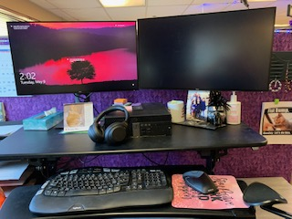
Recommended Computer Equipment
A decent CPU (recommend Intel Core i7 or above)
RAM: at least 8 GB RAM
Monitor screen: at least HD resolution (Preferably 2 screens)
A dedicated graphic card is recommended for the best visual performance
Noise cancelling headphones
Ergonomic mouse

Slide 4
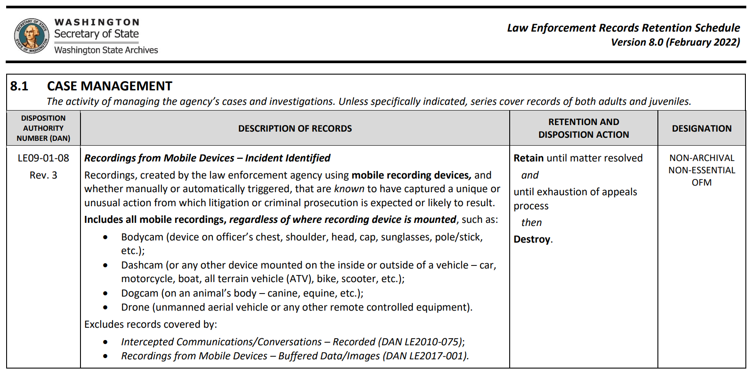
Setting up Retention Categories

Slide 5
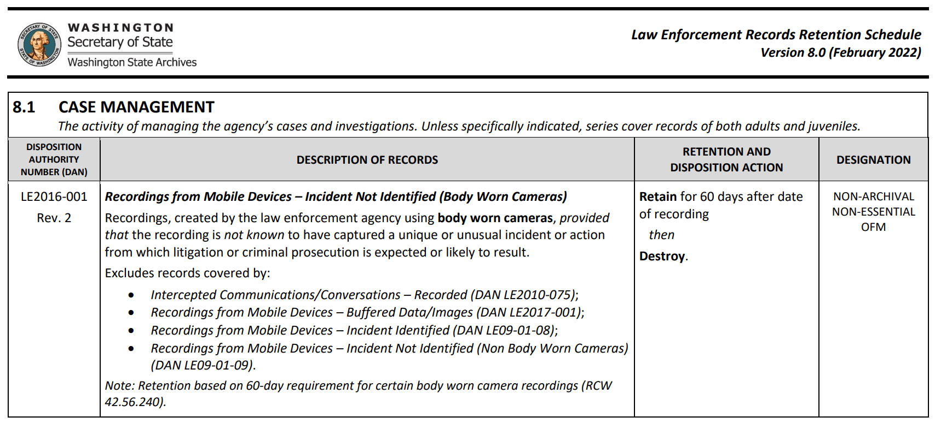
Setting up Retention Categories

Slide 6
Setting up Retention Categories
Citations – Driving Under the Influence Retain for 10 years after date of issuance
Citations/Notices of Infraction Issued Retain for 3 years after date of issuance
Case files – Other cases (Routine) Retain for 5 years after conclusion of investigation AND until exhaustion of appeals process
Solved Homicides Retain for 20 years AND until exhaustion of appeals process
Sex Offender/Sexually Violent Offense Retain for 5 years after conclusion of investigation AND until exhaustion of appeals process THEN transfer to Washington Association of Sheriffs and Police Chiefs for permanent retention (WASPC Sex Offense Imaging Archive cjis@waspc.org)
Traffic accidents with fatality or Retain for 50 years after conclusion serious injury of investigation
Unsolved Homicides, Missing persons, Retain for 75 years after case opened AND until no longer and Unidentified Bodies needed for agency business

Slide 7
Example of Retention Categories
All Reports 10 years
No Report/No Enforcement 90 days
Traffic Stop (Non DUI) 3 years
  Homicide (Solved) 20 years
  Missing Person/Unsolved Homicide/Unidentified Bodies 75 years
  Fatality/Serious injury Accident 50 years
  Training Demo/Accidental Activation 7 days
  Restricted Until manually deleted
  Records Hold/Litigation Hold – Records use only Until manually deleted
  LEMART (Independent Investigative Teams) Until manually deleted

Slide 8


Setting up Users
Who needs access and what type of access/permissions
  Officers/Deputies
  Command Staff
  Detectives
  Records/Evidence staff

Slide 9

Training in Public Records and BWC Program
Know your public disclosure laws RCW 42.56.240
Register for any training available
  WAPRO
  LEIRA
  Washington State Attorney General’s Office
  MRSC
  Washington State Archives
  Body Worn Camera Vendor training
  Reading updates/release notes provided by Body Worn Camera Vendor
  Attending Body Worn Camera Vendor conference

Slide 10

Maintaining Database of BWC Program
Making sure videos/photos stored in BWC database are labeled properly
  Ensure that Video/Photo is properly identified (case number)
  Ensure that Video/Photo is properly categorized with correct retention
  Use RMS to identify Video/Photo to properly ID/categorize
  Check Videos/Photos on a daily basis for errors
  Communicate with Officer/Deputy with any questions

Slide 11

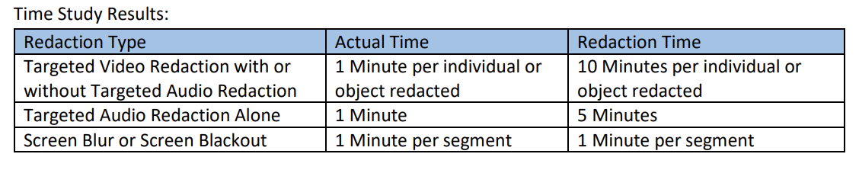
Time Studies
Seattle Police Department conducted a time study to determine the amount of time it takes to redact BWC recordings and these are their time study results:
Source: Seattle Police Department Redaction Cost Study Revised 2018

Slide 12

Dedicate time for reviewing/redacting BWC videos
If you are required to do other tasks, know that it is difficult to stop and start reviewing/redacting BWC videos when attempting to multi-task.
If possible, try to set aside uninterrupted time for reviewing/redacting BWC videos.

Slide 13

Slow Beginning
Know that in the beginning of your deployment of a BWC program, requests are going to come in slowly at first but once the public knows you have BWC videos, the PDR requests will increase.

Slide 14


Take care of yourself
Counseling for traumatic events in videos
Peer Support
Hobbies
Overall Mental Health
Watching BWC videos is like looking through the eyes of the officer, seeing and hearing what they do. They handle some very traumatic events and receive training on how to cope.

