Slide 1
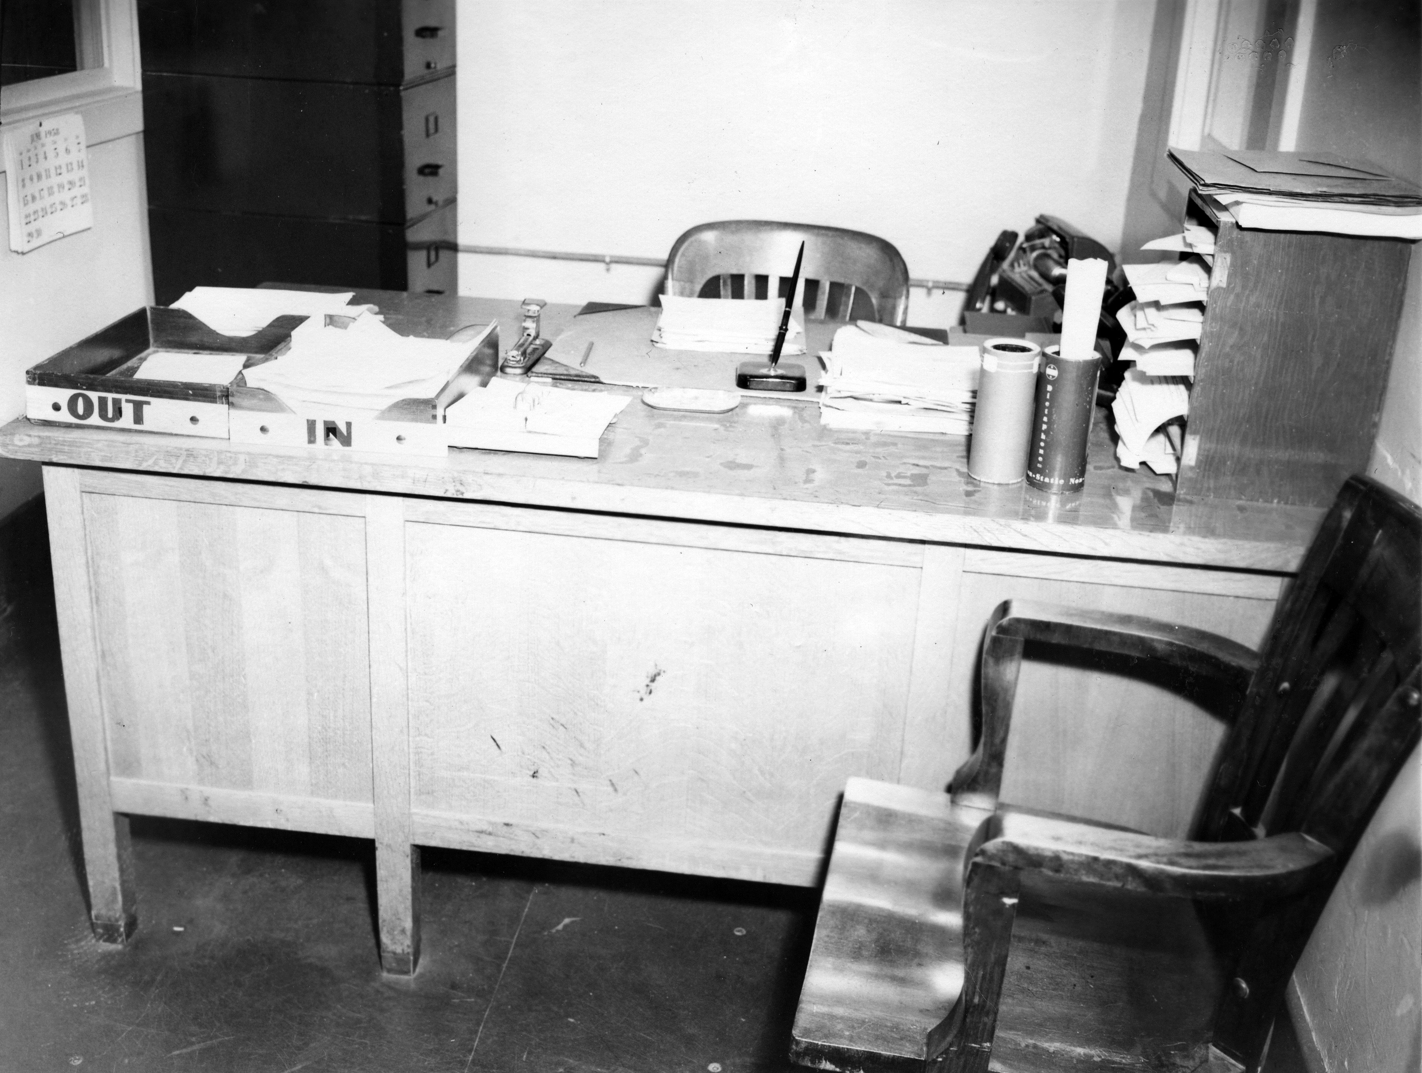
ELECTRONIC RECORDS MANGEMENT from CREATION to DISPOSITION
Caseworker’s office, 1958, Department of Corrections,
McNeil Island Corrections Center Photograph Collection, 1855-2010, Washington State Archives
Notes:
Good afternoon, everyone!
Welcome to Electronic Records Management from Creation to Disposition
My name is Rachel Wilson.
I'm more than a year into my consultant role with the Records Management Team at the Washington State Archives and I’m here to say that I’m still learning. Feeling like a perpetual student can be uncomfortable, but every day I'm excited by emerging records management tools and concepts. I’m also excited to have this opportunity to learn alongside you all this afternoon. Some of this material is new to me as well, so I look forward to working through any questions you may have at the end of the presentation.

Slide 2
AGENDA
  Same Goals, Different Strategy
  Electronic Records
    Creating & Receiving
    Using
    Storing
    Destroying or Preserving
  Q & A
Notes:
I’ll kick off this afternoon's session by outlining what does and doesn’t change about records management when it comes electronic records.
Then I’ll dive into a record’s lifecycle, pausing along the way to highlight important electronic management considerations. At each stage I’ll offer actionable strategies to improve your electronic records management.
And at the end I hope we can have an informal conversation about the specific electronic records management challenges you and your agencies are working to address.

Slide 3
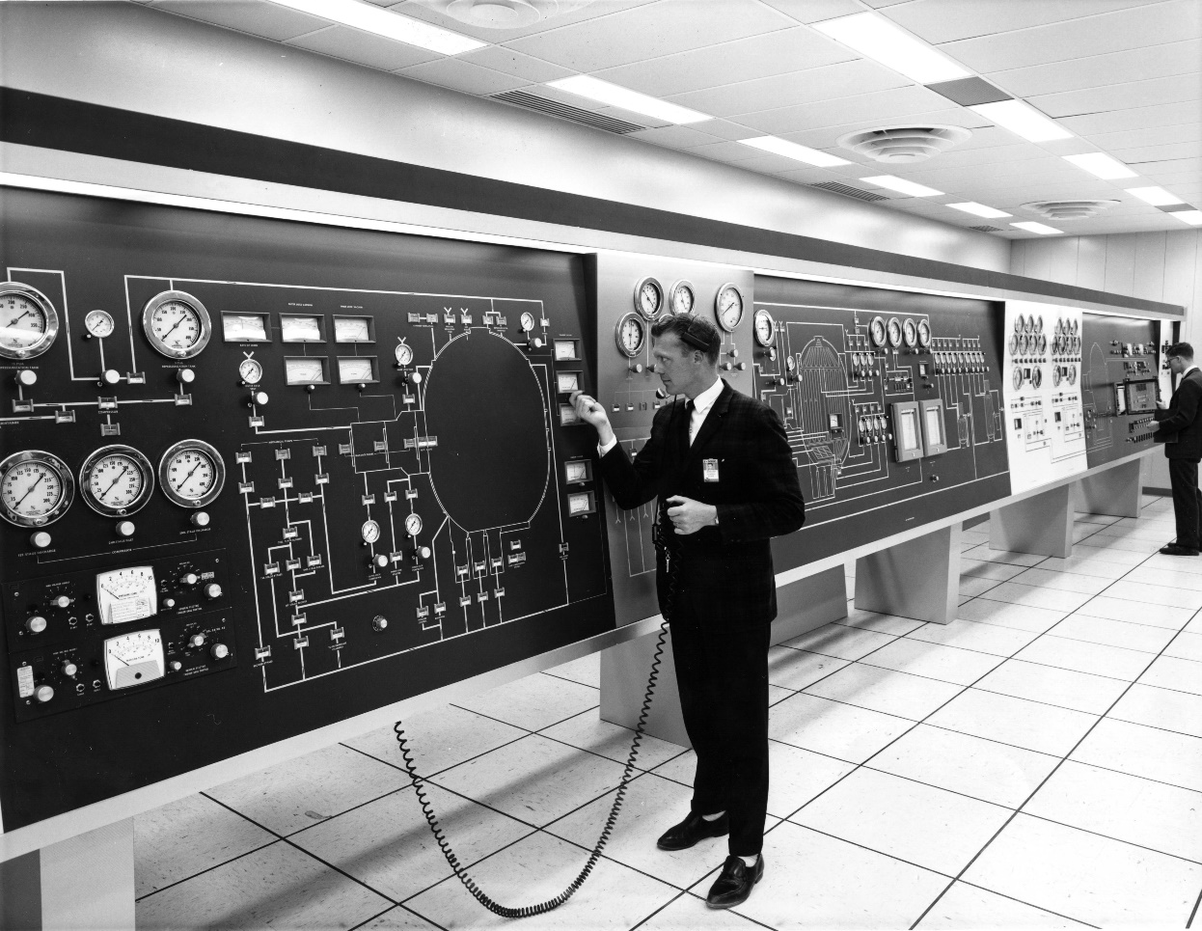
GOALS
Trustworthy
Complete
Accessible
Durable
Vacuum Chamber Control Panel, 1960-1970, Boeing Company,
General Subjects Photograph Collection, 1845-2005, Washington State Archives
Notes:
Before we get into the body of this presentation, I want to offer some perspective. The good news is that retention schedules and the foundational responsibilities of records management haven’t changed. Whether a piece of paper or PDF, retention is not determined by the format of a record but by its function or content. The goal of records management is still the same. Whether paper-based or electronic, records need to be trustworthy, complete, accessible, and durable.
What changes is how we meet these goals. Instead of file folders tucked away in cabinets, we have electronic files saved to folders and sub-folders across various storage platforms. These electronic file folders resemble their paper equivalents but have much greater functionality. It’s never been easier to access or share a record. But as technology evolves and the volume of electronic data increases, we've got to rethink the ways we manage information.
There are SO many options out there, but your agency has the POWER OF CHOICE to meet the goals of electronic records management in 2022 and beyond.

Slide 4
Creating & Receiving
Organizing Electronic Files
File Name Convention
Digital Signatures
Notes:
The life cycle of a record begins when the record is created or received “in the transaction of public business.” You won't need to start from scratch with organizational structure, file names, or digital signature adoption. But the birth of a public record is the perfect time to take these things into consideration. We are creating and receiving records all the time, so there are a lot of opportunities to get started.
There will never be a perfect time to pivot in how you approach the management of digital records, so there really isn’t a bad time to get started either. It’s important at this early stage to make sure everyone understands their records management responsibilities. Getting your colleagues on board will take some training. But the outcomes align with every agency’s legal responsibility to manage their records.

Slide 5
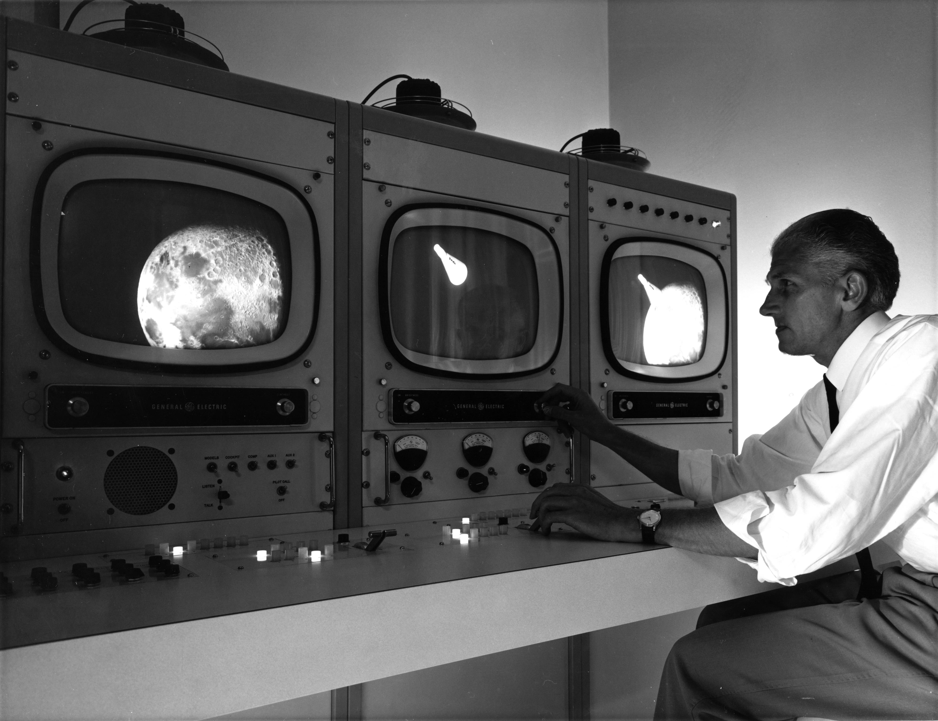
Organizing Electronic Files
A control room at the Boeing Space Center, 1960-70, Boeing Company,
General Subjects Photograph Collection, Washington State Archives
Nest folders within folders
Empty your recycle bin regularly
Keep your files in a folder
Give files logical, specific names
Maintain a folder structure
Backup files regularly
Notes:
Organizing your electronic files is one of the most important steps you can take to get a handle on your electronic records. It may also be one of the most difficult steps to nail down. A digital file plan or organized file structure helps you understand what you need and where you can find it. The challenge lies in scaling that understanding across staff and time. Everyone at your agency needs to be on the same page about what lives where and for how long. Access levels may look different from person to person. But a digital file plan should work across your agency to make retention and records management achievable.
The people: The biggest hurdle in the adoption of an office-wide digital file plan is getting your team on board. Everyone has a different comfort level with technology, so make sure that any system or workflow you develop respects that. That respect is going to go a long way in getting buy-in from your colleagues and executive team. Also, be clear about what you do and don’t understand about the work of each department within your agency. Your departmental partners are integral to the file plan development process, so take your time with this step.
The work: Working in tandem with your departmental partners, you’ll want to get a comprehensive look at where all the digital files are. What is being stored on staff’s local drives, shared drives, email accounts, cloud storage, external hard drives? Make sure to keep tabs all the nooks and crannies digital files can fall in so that you have a complete inventory at the end of this process. Your inventory can be as simple as a spreadsheet of all the files/file names and their locations/file paths.
Once you know what you have, you’ll want to start thinking about how you’ll want to store those files going forward. Create categories of records that relate to a particular function using your records retention schedules. For each file, determine what functional category it lives in, what records series it falls under, and what the applicable retention period is. As you work through the files, you’ll find a lot of material that has met retention. Those files should be flagged or set aside so that they can be defensibly deleted when ready. Develop a file structure that minimizes the number of folders and sub folders, is clearly labeled and broadly understood, and doesn’t interfere or interrupt a department’s workflow. The easiest digital file plan to follow is going to be the most successful.
So, here’s my concrete, actionable advice for organizing your electronic records:
Make friends with colleagues across departments, break out your favorite spreadsheet tool, and document the files you have. Use that information to develop and put in place a plan for how you and your team want that material to be organized going forward.

Slide 6
File Name Convention
Rachel’s Brownie
Recipe
TEST
09-2022
.docx
Identifying Name
Document Type
Status
Date
Notes:
After thinking about file plans, file-naming conventions should be a palate cleanser. Your file plan, folder structure, and your file names should be clear and concise. You want them to be simple, understandable and brief, but you also want them to be unique. There are several ways to achieve this (and most of them include numbers or dates). But you need to decide on the convention that works best for you and your agency.
Your folder structure should work with your file names to avoid redundancy and privilege legibility. Remember that no system is perfect, and we are all human. When you fall out of step with your file-naming conventions, your folder structure is there to keep you organized or vice versa. You'll always have more files than folders, so privilege the level of organization that works consistently across your office.
So, here’s my concrete, actionable advice for file naming conventions:
Have an internal informational dashboard or a shared agency destination that everyone on your team has eyeballs on? That’s a good place to have your file-naming convention posted loud, legible, and clear. Make it visual. Make it simple. Make it easy to adopt.

Slide 7
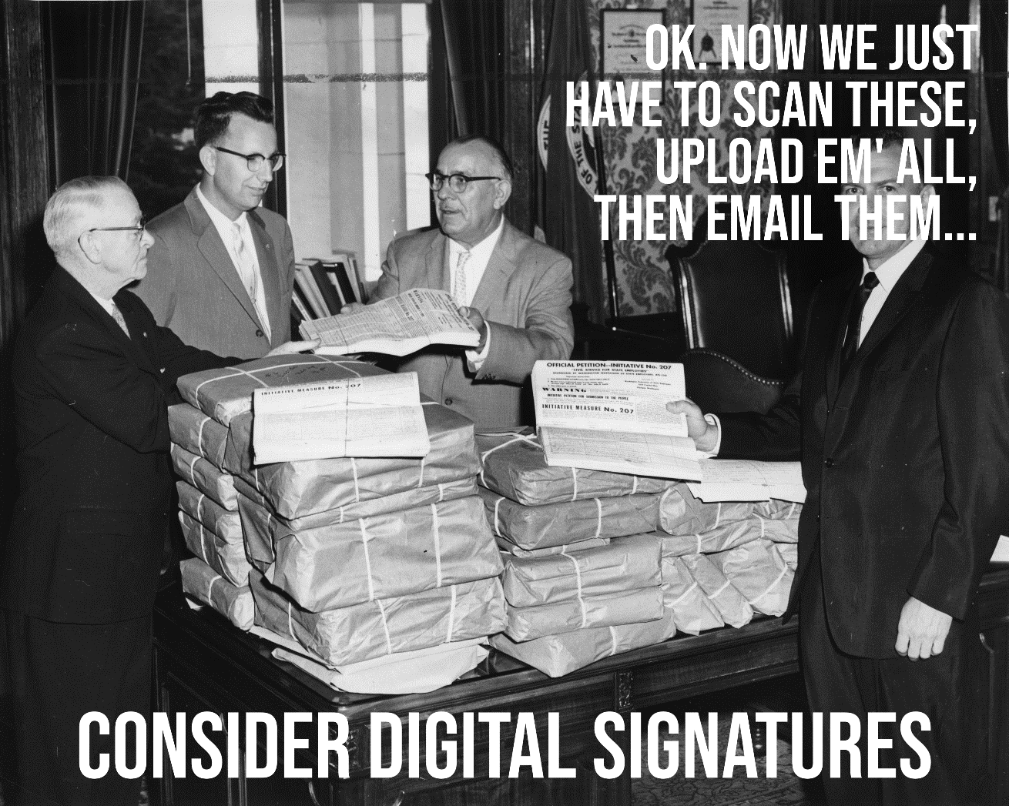
Digital Signatures
Initiative 207 petitions, 1960, Merle Junk, General Subjects Photograph Collection, Washington State Archives
https://mrsc.org
Notes:
More often than I’d like, the question of printing digital-born records to collect wet signatures comes up. It’s a labor-intensive process that grows with the volume of records at hand. And it leaves a lot of room for error. Almost all the public records we generate these days are born digital. And to fulfill legal retention requirements, they need to stay digital. However, sometimes a signature is necessary to authorize a document. Many of us have grown accustomed to signatures that represent our own unique personalities and preferences. But these days our signatures might look more like a scribble on a cashier’s screen.
Like a lot paper processes, signatures have gone digital. Digital signatures carry the same legal weight as a wet signatures in Washington state, unless otherwise mandated. Agencies are encouraged to adopt policies and procedures that govern the use and acceptance of electronic signatures. That policy should address how the digital signature is created and stored, what type of electronic signature is required, and how the agency exercises control over that signature. These considerations are outlined in the Uniform Electronic Transactions Act (UETA).
So, here’s my concrete, actionable advice for digital signatures:
Visit MRSC for sample digital signature policy language and draft some policy language of your own.
https://mrsc.org/Home/Stay-Informed/MRSC-Insight/April-2020-1/Using-Electronic-Signatures-During-Emergencies.aspx

Slide 8
USE
Leaving a Trail of Crumbs/Versioning
Metadata Management
Accessibility
Notes:
Hopefully, you are never juggling more than a few projects at one time and that your inbox doesn’t haunt your waking work-life. But reality is usually a little more complicated than that. You should only ever have a small percentage of your total records in play at any time. But we can all relate to the drafts, duplicates, and copies that threaten to undermine our file plan or dreams of inbox zero.
The trick is to keep your ACTIVE records pared down as much as possible, while keeping the drafts and duplicates at bay. Everything gets filed away until it has met retention. Digital technology makes access so much easier. But to contend with all the emails and documents you create and receive, you’ll want to peer into the back end of versioning, metadata management, and accessibility.

Slide 9
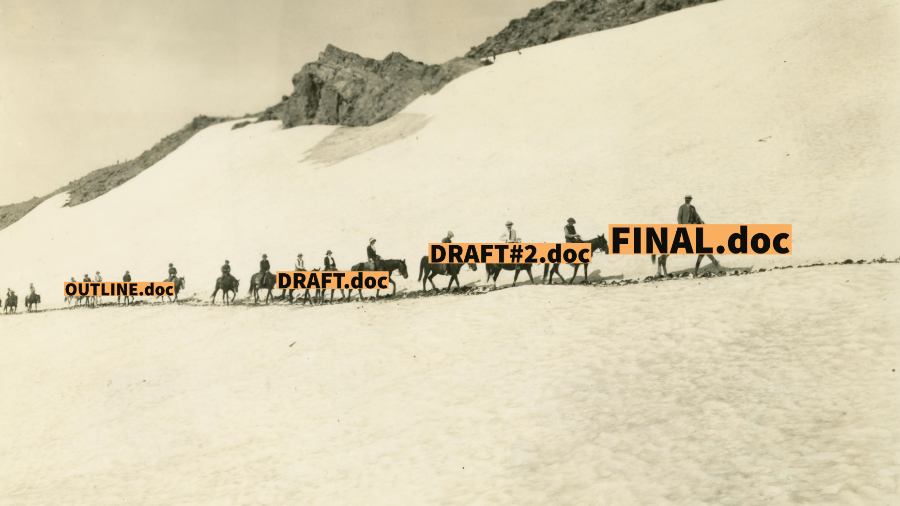
Leaving a Trail of Crumbs
Edith Glacier, Mount Rainier National Park, 1880-1940,
State Library Photograph Collection, 1851-1990, Washington State Archives
Notes:
In grade school, it took some sleuthing to tell who’d been copying who during an essay test. One recognizable paragraph later and the teacher would work to determine whose work originated with whom. Today, your computer takes care to authenticate any record of your work. Audit trails or logs help you identify and reconcile any possible records tampering.
On paper, it wasn’t always clear who accessed what record and how. But today's computers can timestamp any visits or alterations made to a document. This kind of transparency supports the trustworthiness and completeness of a record. An audit trail or log is a digital, chronological timeline of changes made to a document that lives in the metadata of that document. Electronic audit trails enable us track the development of records and alert us to any inconsistencies. Versioning allows us to revisit previous iterations of our work.
Audit trails support the broader goal of compliance within electronic records management. You may not always be aware of the audit trails being generated in the background of records you create and edit. But they’ll be there when and if you need them to confirm your work and processes.
So, here’s my concrete, actionable advice for versioning:
Whether a big collaborative project or your own work, only break it down into separate versions at critical junctures, be clear and concise with your file naming, and merge when appropriate and necessary.

Slide 10

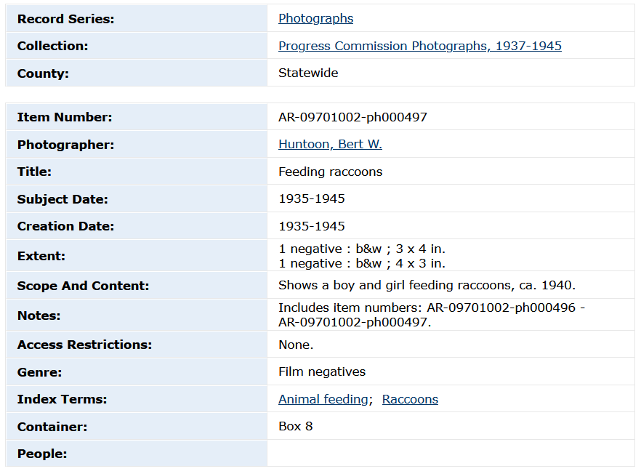
Metadata Management
Data
Metadata
Notes:
You can’t get through an electronic records management training without talking about metadata. Metadata is data about data. Metadata can describe paper or electronic records. But it becomes more important when there is no physical object to interact with. Take this scanned image of a couple feeding a raccoon, for instance. The metadata associated with the digital image is descriptive (photographer, date, content), but also technical (file name). Every electronic record you create or receive is going to have metadata associated with it. This extra information helps to distinguish one electronic record from another. This way, you can retain and provide access to this particular raccoon photo well into the future.
All the electronic records we retain wouldn’t be of much use if we didn’t have the metadata in place to make those records searchable and discoverable. Some metadata is automated, like the set of properties created with every word document. And some metadata is created manually, like subject tags in an Instagram post. Metadata helps us find important details in a document. It lets us know when a record was created and used so that we can apply retention and dispose of it when possible. And it helps organize electronic records to serve the goal of accessibility.
So, here’s my concrete, actionable advice for metadata:
Unless you are an information professional, it’s okay to not think about metadata. However, I challenge you to right-click any file on your computer and explore its PROPERTIES. You might be surprised by what you find.

Slide 11
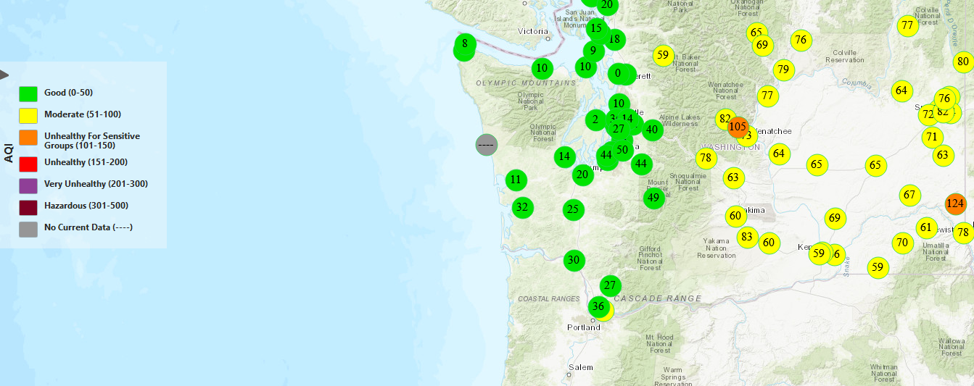
Accessibility
Notes:
As agency representatives managing public records, access is the core of everything we do. Whether coordinating with the public on a public records request, facilitating internal access to support day-to-day operations, or transferring material to the digital archives. Access is a defining goal of the work of electronic records management. Making electronic records accessible means a lot of care and organizational know-how on our parts. But when it works, it makes SO much possible. Visit the Department of Ecology’s website and you can gauge the quality of air you’re breathing all over the state. The Washington State Department of Transportation maintains a live traffic map to keep you safe and informed. And the Washington State Archives helps people connect to their Washington Heritage everyday.
Accessibility can’t be condensed into one piece of actionable advice.
The best thing you can do is take a moment to consider how someone else might interact or access your work. As yourself some questions:
Does the language I use confuse, more than help people?
Can this process be simplified?
Does this acronym mean anything to anyone outside of my team?
When you think about accessibility, you’re really thinking about others.

Slide 12
STORE
Digital Storage
Conversion/Migration
Privacy/Security
Notes:
Physical storage facilities dominate the landscape of our modern lives. Got more stuff than your home can hold? Put it in a storage facility. Out of sight, out of mind.
Digital storage can have the same effect. But the countless files you manage shouldn't be shoved in a folder without organization or access in mind. It’s 2022 and you can store your files locally on your computer. On a shared drive that everyone in your agency has access to. Maybe your saving files to an external hard drive you keep stored at your desk, or in a cloud serviced by a huge tech company. Choosing where to store your agency’s electronic records is no small decision. Digital storage affects each of the goals of electronic records management.

Slide 13
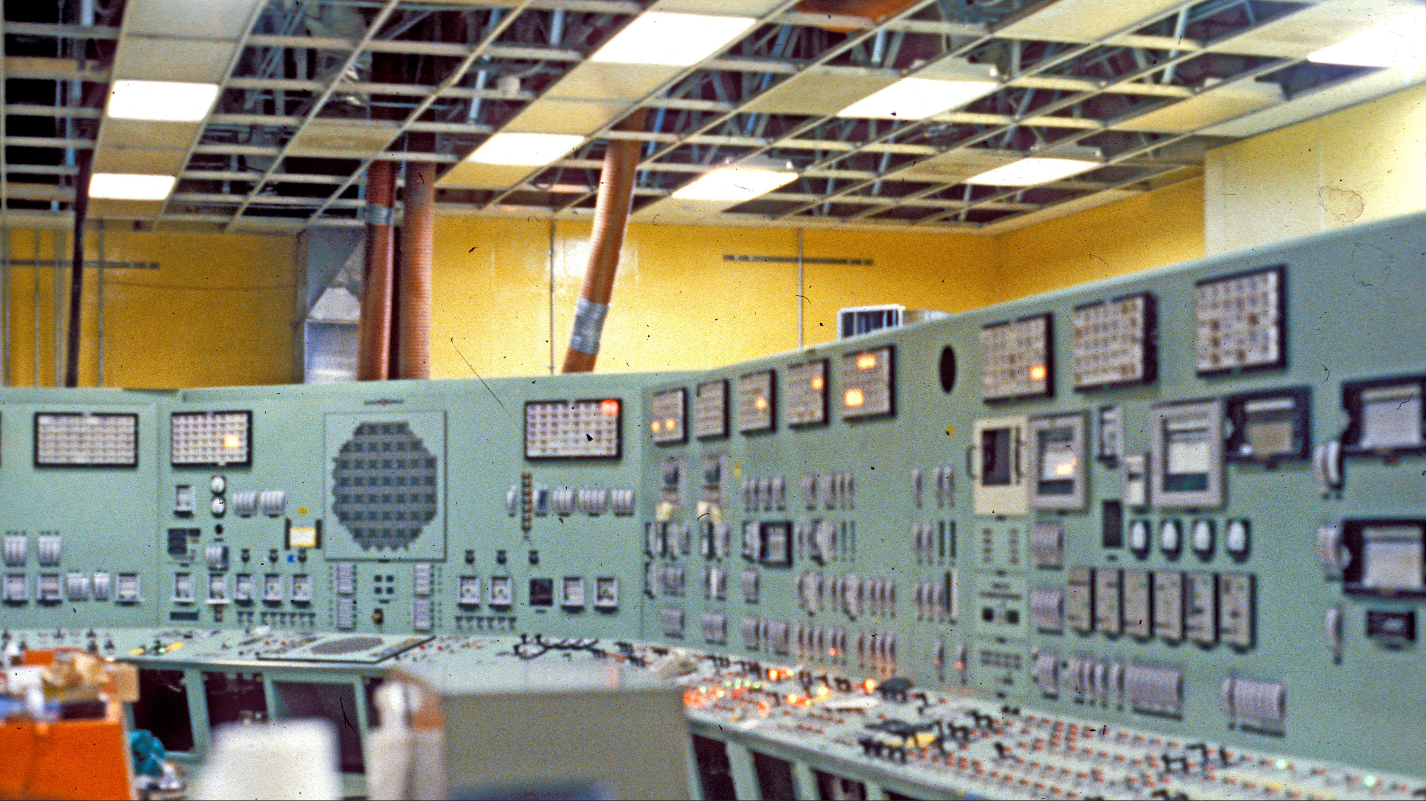
Digital Storage
Hanford Fast Flux Test Facility, interior, 1970-80,
General Subjects Photograph Collection, 1845-2005, Washington State Archives
Notes:
If you are anything like me, your work is saved and stored across several different platforms.
New emails live in my Outlook until I’ve addressed and filed them away.
I keep active development drafts saved to my local computer drive until I file them away into my team’s content management system.
My office uses a chat application for transitory correspondence.
And I use a shared drive for records I want to share with the team.
If you’re lucky, you may be using an enterprise content management system (ECMS). My team files away most of its electronic records into folders maintained and managed in an ECMS. This software solution helps us fulfill our retention requirements and makes it easier to batch-destroy records that have met retention. Choosing the appropriate storage locations for your agency is all about asking the right kinds of questions:
How is this storage location secured, and can it balance our privacy and access needs?
How good is it’s search functionality? Will we be able to find what we need when we need it?
How can we organize and manage the records we keep in this storage location?
So, here’s my concrete, actionable advice for digital storage:
Reach out to your IT team to get an idea of the volume of data that lives across your storage locations. Putting terabytes of data into perspective should inspire you to question your storage present and start planning for your storage future.

Slide 14
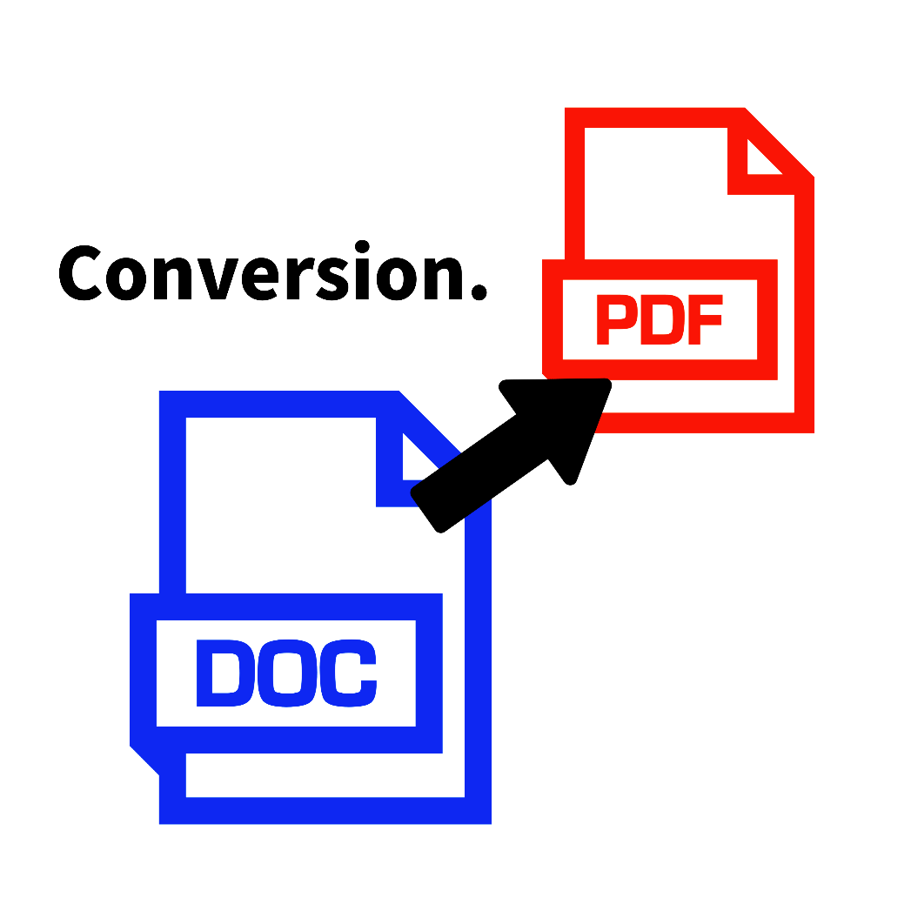
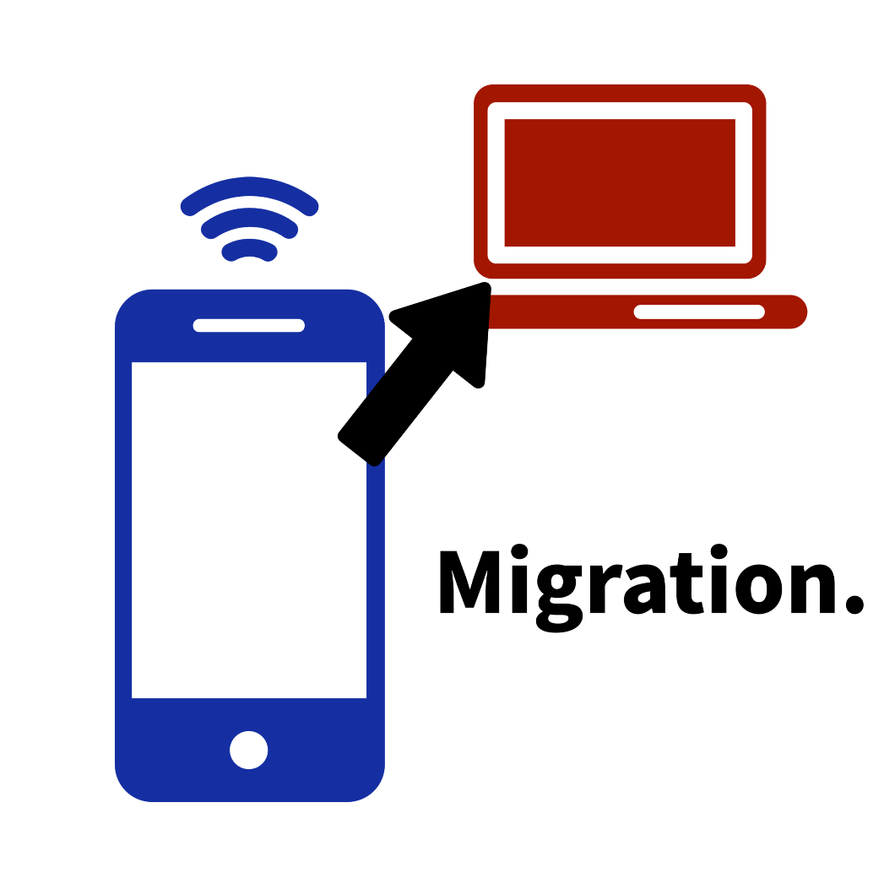
Conversion/Migration
Notes:
I learned to type using a software program loaded onto a floppy disk and inserted into a computer I’d laugh at today. That was in the early 90’s. You don’t have to have been around for too long to notice how quickly technology changes, and in turn, the electronic records that we create and receive. A lot can happen in the length of a retention period. It’s you and your agency’s responsibility to make sure that your electronic records are accessible no matter what year it is. Conversion and migration are the best strategies for preserving access to your electronic records.
When you convert an electronic record, you are changing its format.
And when you migrate an electronic record, you are moving it to a different location.
In some cases, you’ll need to convert your files before you can even migrate them, depending on the systems at play. Have you ever had to move your information from one phone to another or from one computer to another? That’s migration. Ever turned a word document into a PDF? That’s conversion. Migration and conversion allow you to meet ALL the goals of electronic records management.
When deciding where to migrate or what to convert your files to, you'll want to consider the following questions:
Will it be accessible?
Can this file format be supported in the long-term?
If you move or convert the files, will they lose anything in the process?
Does the new format or storage location support your business/informational needs?
My concrete, actionable advice for conversion or migration:
Start planning for the future and make an inventory of all the file formats and storage locations you use.
Are these formats in heavy rotation or do you need to consider converting to a more appropriate format?
How about your storage locations:
Are they secure? Are they even storage solutions? (your email inbox is not a storage solution)
Will they see you through the next ten years of technological evolution?

Slide 15

Privacy/Security
Betty Reilly, Department of Employment Security, 1976, Ron Allen,
Susan Parish Photograph Collection, 1889-1990, Washington State Archives
Notes:
Privacy and security are concepts that have come up earlier in this presentation, but let's focus-in. Electronic records are more accessible, but that access creates greater opportunity for information to fall into the wrong hands. These records can include sensitive data that could jeopardize a person or agency’s privacy and sense of security.
Data privacy is regulated by US law. It is our responsibility to use electronic records management to exert control over the sensitive information in our care. The potential for making private data public, human error, the exponential growth of information, and the vulnerabilities of new technologies each poses risk to our agency’s security.
Make sure your agency’s internet connections and data storage are password protected.
Take advantage of any access controls in your electronic storage locations.
Maintain and retain the minimum number of records necessary to conduct business.
Consider encrypting sensitive documents.
Focus on the safety precautions you and your agency can control.
To shore-up your records security, talk to your IT team. Tell them what you are storing and where. And ask how you can be doing a better job to protect and secure sensitive information.

Slide 16
DESTROY or PRESERVE
Empty your Recycle bin
Digital Destruction
Electronic Records Transfer
Notes:
A lot of records management focuses on retention. But one of the most important stages of a record’s lifecycle is when it's destroyed or transferred to the Washington State Archives.
Agencies aren’t required to destroy their non-archival electronic records that have met retention. BUT they are encouraged to do so. To document this destruction, you’ll want to maintain a destruction log. That log should include the record's disposition authority number, the record series title, the date range of the records, and the actual date of destruction. You can find a sample destruction log on the Washington State Archives website. We encourage you to use it as a template for your own destruction documentation.
For electronic records designated ARCHIVAL, you’ll need to reach out to the Washington State Archives. We'll guide you through the process of appraisal and transfer. Archival records have long-term public research value and need to be preserved and managed in perpetuity. Thankfully, that isn’t work you need to do. The Washington State Archives is here to take those archival records off your hands. We'll protect them, so you can save time and money.

Slide 17
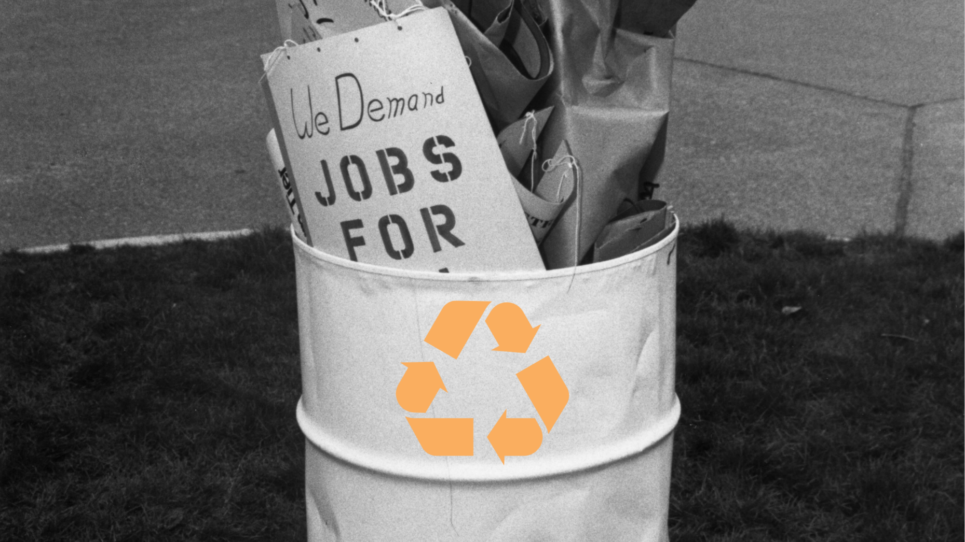
Empty Your Recycle Bin
Protest signs in trash, 1982, Gant W. Eichrodt,
General Subjects Photograph Collection,
1845-2005, Washington State Archives
Notes:
I don’t do this every day, but I try and do this at least several times a week. I empty my recycle bin. Even when that little icon shows me I’m empty, I’m still going to right-click and empty that sucker. The reality of throwing away a digital document is that deleting a record from your computer doesn’t wipe if off the face of the earth. You must visit the little trash can icon on your desktop to do that. When you think about it, it mirrors the process we have with paper records. The trash doesn’t take itself out. So, when you throw something away, it sits in your trashcan until you take it out to your city trash can. If anything, digital trashcans are a lot tidier. There is no better way to exercise control than taking out the digital trash. This is great, for those of us with trigger fingers that find ourselves putting active records in the trash can, where you can then locate and quickly restore it. But it does add another layer of complexity in your efforts to de-clutter.
So, here’s my actionable, concrete advice:
Empty your recycle bin. Witnessing that tiny visual shift from a full trash can icon to an empty one is a tiny bit satisfying. Which is enough.

Slide 18
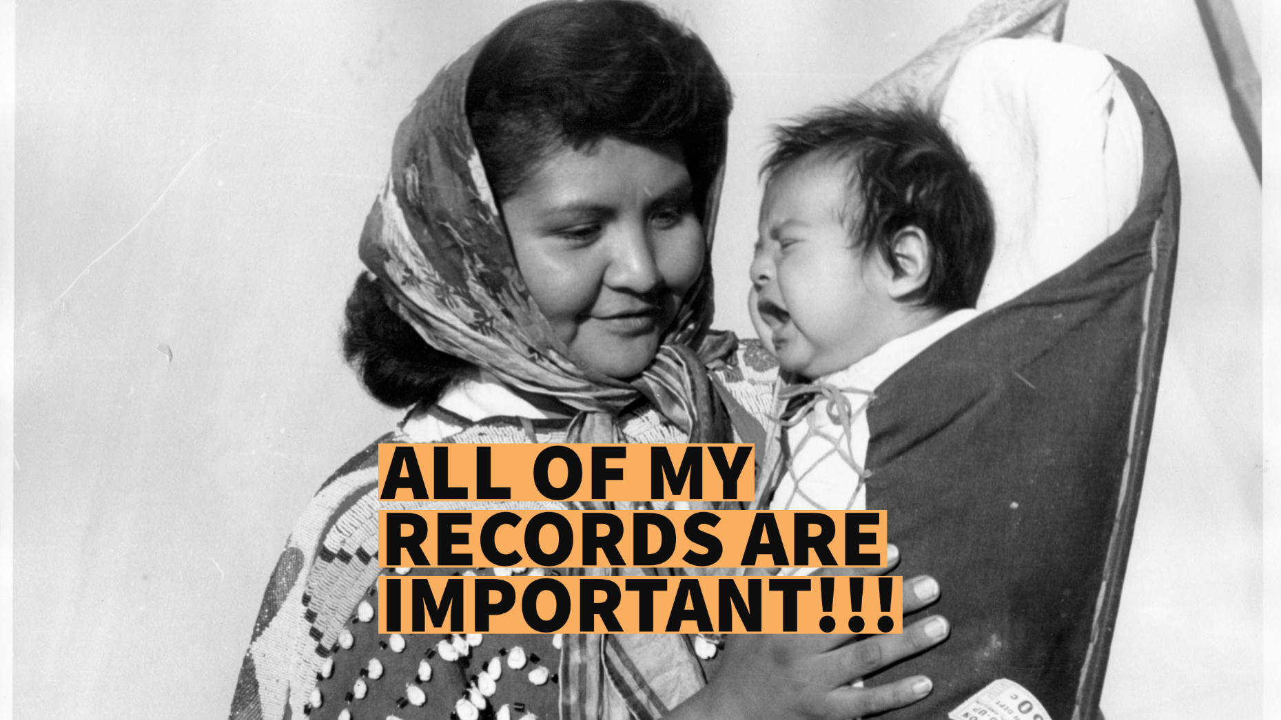
Digital Destruction
Mrs. Sylvester Minthorn and baby, 1950-60, John W. Thompson,
State Library Photograph Collection, 1851-1990,
Washington State Archives
Notes:
Emptying your recycle bin is one thing, but for a lot of us, even getting digital records moved into the trash can is a hurdle. You might be that category of person that files the records they create or receive but doesn’t go in to delete those same records when the retention clock has run out. Some of us might feel trapped by the what-if’s:
What if need to reference that document later?
What if someone requests that record?
What if I destroy something I shouldn’t have?
Digital storage may be cheap, but the ongoing costs of management and the risks of holding onto information past its lifespan is not.
So, what can you do?
Shake off those what-if’s and start making some inroads with your digital destruction. Location by location, apply retention and send what you can to the recycle bin as soon as you can. And don’t forget to document that destruction.
Finally cleared out that folder on your desktop? Treat yourself.
Tackled a bunch of files from that one project that wrapped five years ago? Treat yourself.
Small wins are still wins.

Slide 19
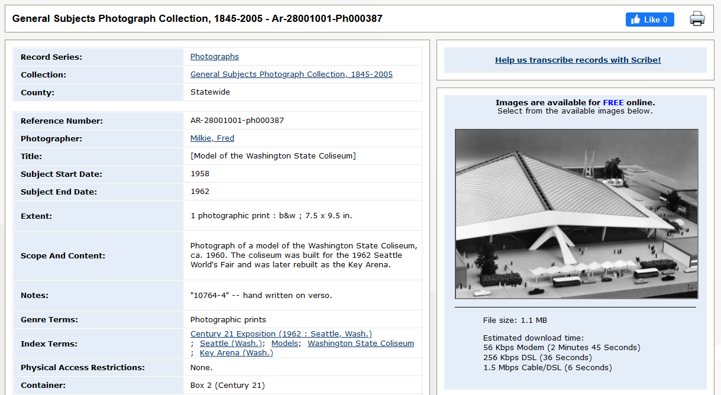
Electronic Records Transfer
Notes:
This process is a presentation in and of itself, but you’ll want to know how to transfer the records you can’t destroy. Because we don’t want you to store electronic records any longer than you need to, the Washington State Archives is here to appraise and permanently retain all your ARCHIVAL records. In fact, it’s our job. Let’s review the process at a high level:
Verify & Reach Out: Use your agency's approved records retention schedule(s) to confirm archival designation. And reach out to the Washington State Archives to kick start transfer or appraisal.
Prepare Your Records: Make sure your meeting records are organized with consistent, short, and descriptive file names. And remove any duplicates or non-archival files.
Index Your Records: Fill-out the appropriate Indexing Spreadsheet Template offered online.
Initial Paperwork: Complete and submit a Digital Archives Initial Transfer Inventory Sheet before signing and returning the Transmittal Agreement.
(Re)Training & Transfer: The Washington State Archives will reach out to review your index, create an Archive This! account, and schedule a training. Together you'll complete your first (or sixth) transfer if necessary.
Success & Access: Once you've completed the transfer, you'll receive a confirmation of receipt and ingest via email. You can now access the records on the Washington State Archives website.
My hot take for the electronic records transfer process?
Identify the Washington State Archives branch that serves your region and reach out. They’ll guide you through the process.

Slide 20

It’s a lot, I know
A.M. Kendrick Photographic Collection, ca. 1890-1976, Washington State Archives
Notes:
I left this slide blank intentionally. Consider it some cognitive breathing room. Take a mental break, we all deserve it. Records management is a lot of active work, and I’d be lying if I said its all fun.
Technology has changed, but the foundational work of records management is still the same.
Records management is STILL knowing what you have, where it is, and how long you have to keep it.
What has changed is the how of records management. Remember that everyone else is in the same boat, and some of us are farther along than others. This is a good thing. Reach out to like-minded agencies to ask how they're managing their electronic records. And always feel free to reach out to the records management team at the Washington State Archives. It’s what we’re here for.

Slide 21
SAY HELLO!
Notes:
If you don’t find what you’re looking for on our website, or you’re not even sure what you should be looking for, we’re here to provide advice and consultation by phone or e-mail.
It’s the best part of our jobs to connect with all the diverse state and local government agency representatives, so don’t be shy with your questions or concerns. All our services are free and there is no record too small or project too big to reach out and ask for help.
Thank you for your time :)

