Slide 1




Records Practical Skills
Redactions

Slide 2
Disclaimer
The information provided in this presentation is meant as general guidance
Specific questions regarding the applicability of a given exemption should be discussed with your legal counsel

Slide 3



Why we redact

Slide 4
Baseline: records are presumed open to the public
Our starting assumption is that a given record is open to release to the public without exemptions
Exemptions must exist within the law
Exemptions are narrowly construed – RCW 42.56.030
All exemptions for redaction must be cited and a brief explanation provided
The agency asserting the exemption must justify the use of that exemption

Slide 5
Philosophy of redaction
Why do we redact information from otherwise public records?
  Common reasons for redaction
    Protects personal information such as SSN, bank account information
    Protects employee information such as address or phone number in personnel files
    Protects legal advice covered by attorney client privilege
  More unusual reasons
    Protects confidential business information
    Protects the location of archeological sites
Notes:
Redact minimum necessary
Example: We redact information from forms but leave the remainder of the form visible.

Slide 6
Exemptions are found in State and Federal statutes
Where do we find the legal justification for redacting exempt information?
  RCW 42.56 contains many exemptions
  RCW 42.56.070 allows agencies to use “other exemptions” included in both State and federal statues.

Slide 7
Where can we find statutes containing exemptions?
MRSC guidance - Public Records Act for Washington Cities, Counties, and Special Purpose Districts Appendix C
Sunshine Committee Website -https://www.atg.wa.gov/sunshine-committee
Legislative and legal updates provided by MRSC, the Attorney General’s Office and your legal counsel
Fellow agencies – We are all in this together

Slide 8
Tools to conceptualize redactions
External Tools
  RCW 42.5
  MRSC guidance - Public Records Act for Washington Cities, Counties, and Special Purpose Districts
Internal Tools
  Exemption code key
    Keyed listing of known exemptions for your agency
  “Local exemption code key”
    Similar to a local retention schedule, the most commonly used exemptions.

Slide 9
Context of information can be important
Some information is exempt from disclosure no matter the context or location of the information:
  Social security numbers
  Credit or debit card number
Requestor is requesting records about themselves or a dependent
  Likely no need to redact information as the requestor already has that information
Request is for a list of names and intent is commercial use
Notes:
When requesting records about “yourself” the PRA may not be the best vehicle to use for the request.

Slide 10
Context of information can be important
Information exempt in one context can be releasable in another
  Medical records gathered by an agency in anticipation of litigation are exempt from disclosure
  Medical records included with a claim for damages are not exempt from disclosure even if both sets of records are the same
Other examples:
  Coroners' reports
  Agency employee personal phone number, exempt in the employee’s personnel file but releasable if included on an office phone list

Slide 11
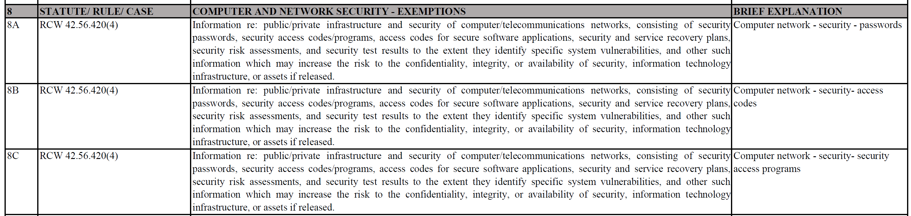
Exemption Code Key
Prepared list of exemptions believed to be applicable to your agency
Notes:
Code is on left hand side
Statute/source
Text of the statute or source
This can appear to be very repetitive as a single citation may cover multiple types of information.
Brief explanation

Slide 12
Exemption Code Key
Uses of the exemption code key
  External use
    Allows staff to redact a document, or portion of one, and include only the key in the redaction. No need to create a redaction log, simply provide a copy of the exemption code key with redacted document
    Can be published as a list of exemptions to meet RCW 42.56.070 (2)
  Internal use
    Can be used to look up potential exemptions

Slide 13
How do you know what to redact?
Use your subject matter experts.
  We cannot always know the content and context of records within our agency. You cannot know the content and context of all the records in your agency (well, I can’t anyway).
  Rely on your co-workers expertise. Call on the people who manage and use the records. Don't be afraid to ask questions.
  Use your legal counsel. Check with your legal counsel if you have uncertainties or questions.
Know your records, what they contain and any potential exemptions.

Slide 14
Releasable information that makes you uncomfortable
Sometimes you come across information in a document that is not exempt from disclosure but the idea of releasing the information makes you uncomfortable.
  Example: Medical information provided as part of a claim for damages
Possible approaches
  Third party notice is an option
  Contact the requestor and ask if they want the information
Notes:
Medical records attached to claims for damages. Request was for general claims, called requestor, did not want it.
Provided notice in our transmittal letter that these were being withheld with their permission
Redacted information with approval of requestor, using Exemption Code Key
Used code “**” and indicated what that meant in the transmittal letter

Slide 15

How we redact

Slide 16
Starting redaction
Blocking specific information (SSNs, employee appraisal scores, identifiable voices) from access by requestor
We need to make sure we are actually doing this, know your tools
Be certain that the tool you are using is actually redacting the exempt information
Notes:
* Example of “word” exemptions in the past

Slide 17
Some possible “gotchas”
Make sure that you are consistent in what is being redacted and the claimed exemption.
  Pay particular attention to duplicate records.
Be aware of email duplication and also attachments.
  How you process the email can affect how you redact it.
Notes:
Know the tools used for extracting/flattening email and how it handles attachments
We use Evermap flattening tool, name:

Slide 18
How do we redact a document?
Identify record as responsive
Identify that there is exempt information in the record
Using appropriate tools "mark" the information as exempt
  Save "marked" copies for potential future reference
Apply the redactions
"Sanitize" the record
  Removes bookmarks
  Removes attachments and links

Slide 19
Common types of records to be redacted
Electronic text documents
  Word documents, email, instant messages, pdf files, data exported from a database
Scanned paper documents
Spreadsheets
Audio files
Video files
Notes:
* Audio and video files require different software for “redactions”

Slide 20
Textual records redaction with Adobe Acrobat
There are numerous tools that can be used for redaction
  GovQA has a tool
  Other third party tools
What follows is a brief tutorial on redaction using Adobe Acrobat Pro DC

Slide 21


Redaction with Adobe Acrobat – Starting the process
If you will be using an exemption code key, have the key or exemption codes you will be using available.
Open the document to be redacted in Adobe Acrobat.
  May need to convert the document to .pdf format first
Select the redaction tool:
Make sure that “Redact Text & Images” is selected

Slide 22
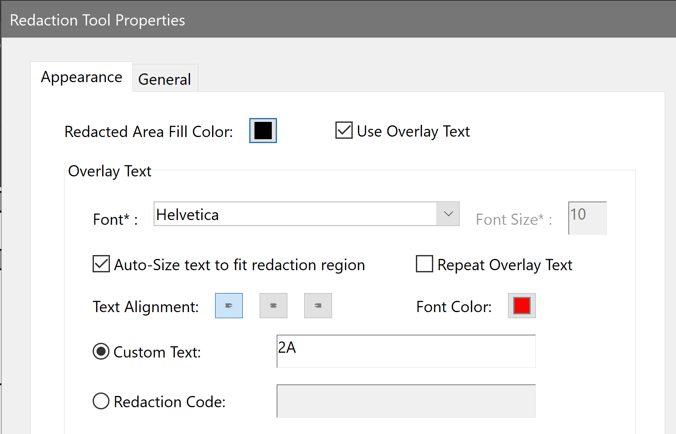
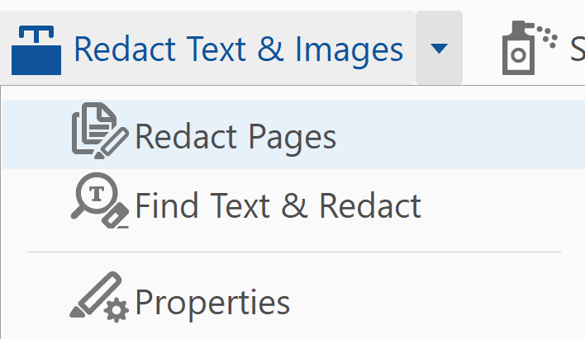
Redaction with Adobe Acrobat - Properties
Set your redaction properties

Slide 23
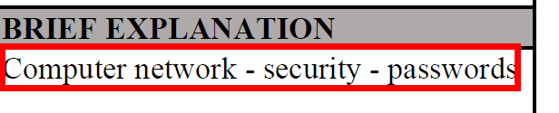
Redaction with Adobe Acrobat - Marking
Mark text for redaction
  While “Redact Text & Images” is selected your pointer will turn into an “I” with a box around it. Any text selected at this point will be marked for redaction.
    Note that you can remove this selection by right clicking and selecting delete or by the keyboard command ctrl+z
  Select text for redaction. Once you have selected the text it will be highlighted in red (by default):

Slide 24

Redaction with Adobe Acrobat - Marking
If you hover over the area marked for redaction you can see what it will look like once redactions are applied
Continue marking all regions for redaction
Note that you can right-click in an area marked for redaction, select “Properties” and change the redaction code for that redaction only.

Slide 25

Redaction with Adobe Acrobat - Applying
Applying redactions
  Once all redactions have been marked click the “Apply” button
  This will walk you through the process of applying redactions
Once redactions have been applied click the Sanitize Document button
  This will remove any attachments and links in the document.

Slide 26
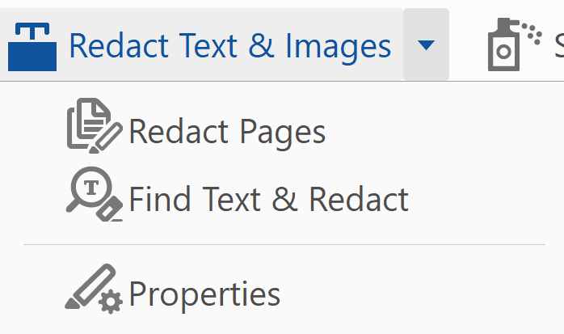
Redaction with Adobe Acrobat – Other Tools
Other methods of redaction in Acrobat
  Redact pages - In addition to marking individual text or images for redaction you can also choose to redact an entire page with one click.
  Find Text & Redact to search for text and mark the located text for redaction.

Slide 27
Redaction with Adobe Acrobat – Other tools
Uses for “Redact Pages”
  This tool can be very helpful if the entire page is exempt from disclosure. Simply mark the current page or the page range for redaction and click OK
Uses for “Find Text & Redact”
  Repeating data such as account numbers
  Names or SSN on forms or multiple pages, can help prevent missing text to redact
  Review before applying redactions
Notes:
Prosecutor uses “Redact Pages” to redact entire pages.
Have used “Find Text & Redact” for account numbers in balance statements

Slide 28
Redaction in other file formats
Excel files
  Delete data in cells, add exemption code into cell. Lock worksheet.
Audio files
  We have had requests in the past for audio files where recognition of the voice would have revealed the identity of the caller.
    Offered a transcript.
    Now have audio software that can alter the voice
Video files
  This is a whole other can of software

Slide 29
Exemption/Withholding Logs
All redactions made must be identified for the requestor.
  RCW 42.56.210 (3) Agency responses refusing, in whole or in part, inspection of any public record shall include a statement of the specific exemption authorizing the withholding of the record (or part) and a brief explanation of how the exemption applies to the record withheld.
Basics for a withholding log
  Name or description of the record
  Date of the record
  Page number for the redaction or the page numbers for withheld pages
  A statement of the specific exemption authorizing the withholding
  A brief explanation of how the exemption applies to the record

Slide 30
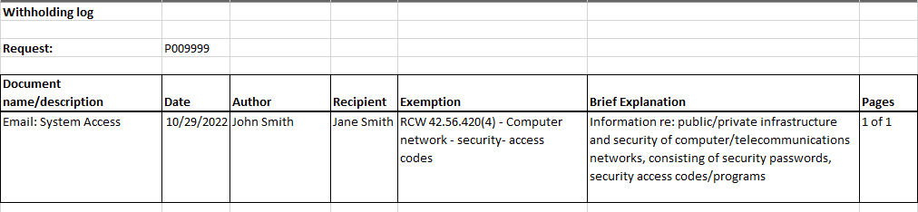
Exemption/Withholding Logs
Example withholding log

Slide 31
Summary
Know your records, or know who does know those records
Know your exemptions
Know your tools

Slide 32

Questions?

