Slide 1

MANAGED RECORDS ARE Accessible RECORDS
Washington State Archives
recordsmanagement@sos.wa.gov
(360) 586-4901
General Subjects Photograph Collection, 1845-2005, Washington State Archives

Slide 2

Benefits of Managing Records
Enables the agency to fulfill its mission
Promotes cost-effective use of agency resources
Promotes open and accountable government
Enables continuity of service in emergencies
Identifies and protects historically valuable records

Slide 3

What is a Public Record ?
For the purposes of retention and destruction, two criteria
(RCW 40.14.010):
Made or received in connection with the transaction of public business
Regardless of format
For public disclosure (RCW 42.56.010):
Any writing relating to the conduct or performance of any government function prepared, owned, used, or retained by a state or local agency
Regardless of format

Slide 4
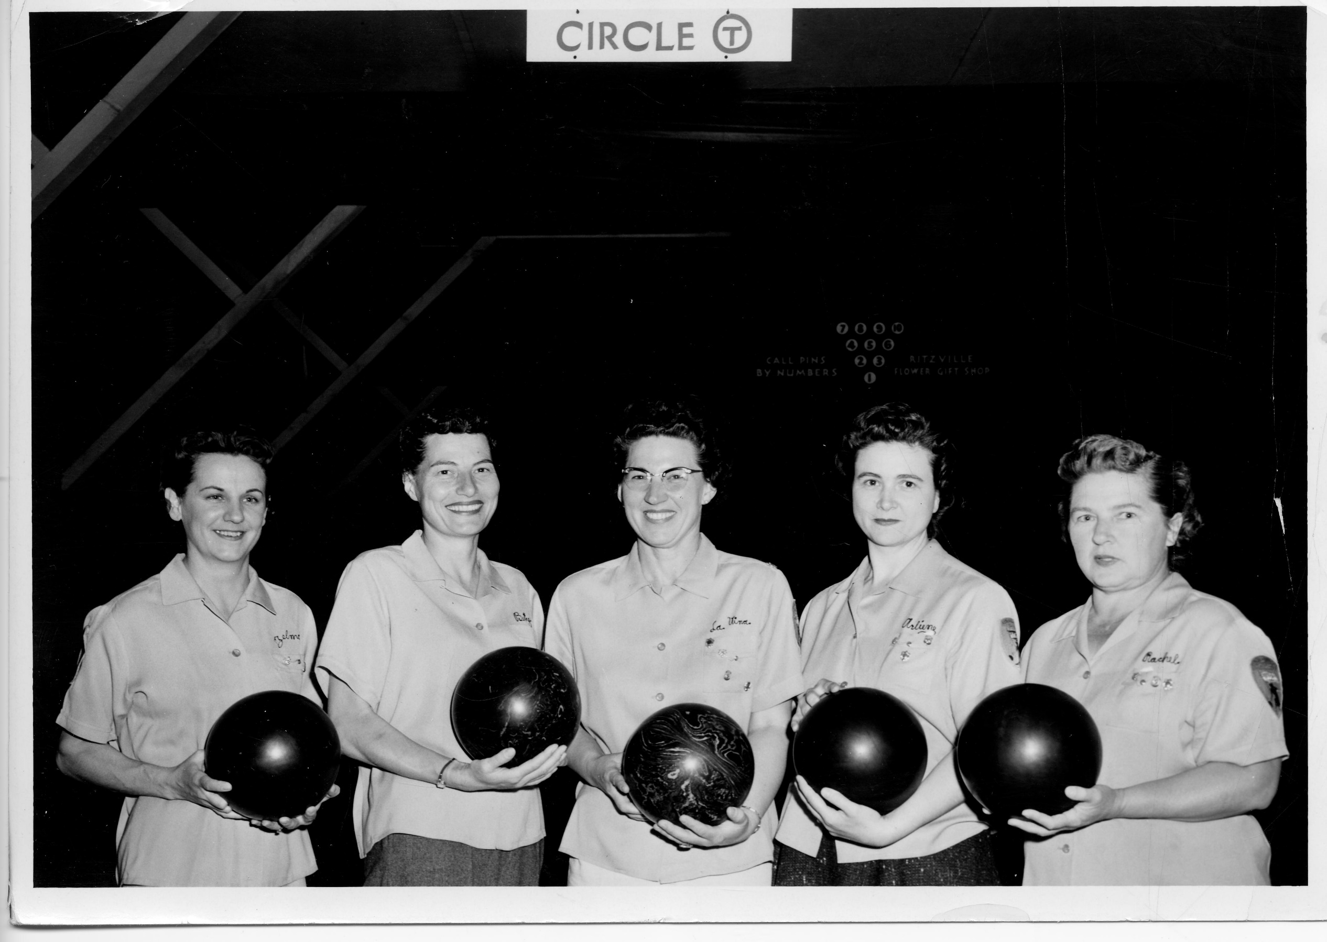

A Record’s Life Cycle
Create or Receive
Destroy or Preserve
Use
Store
A.M. Kendrick Photographic Collection, ca. 1890-1976, Washington State Archives

Slide 5
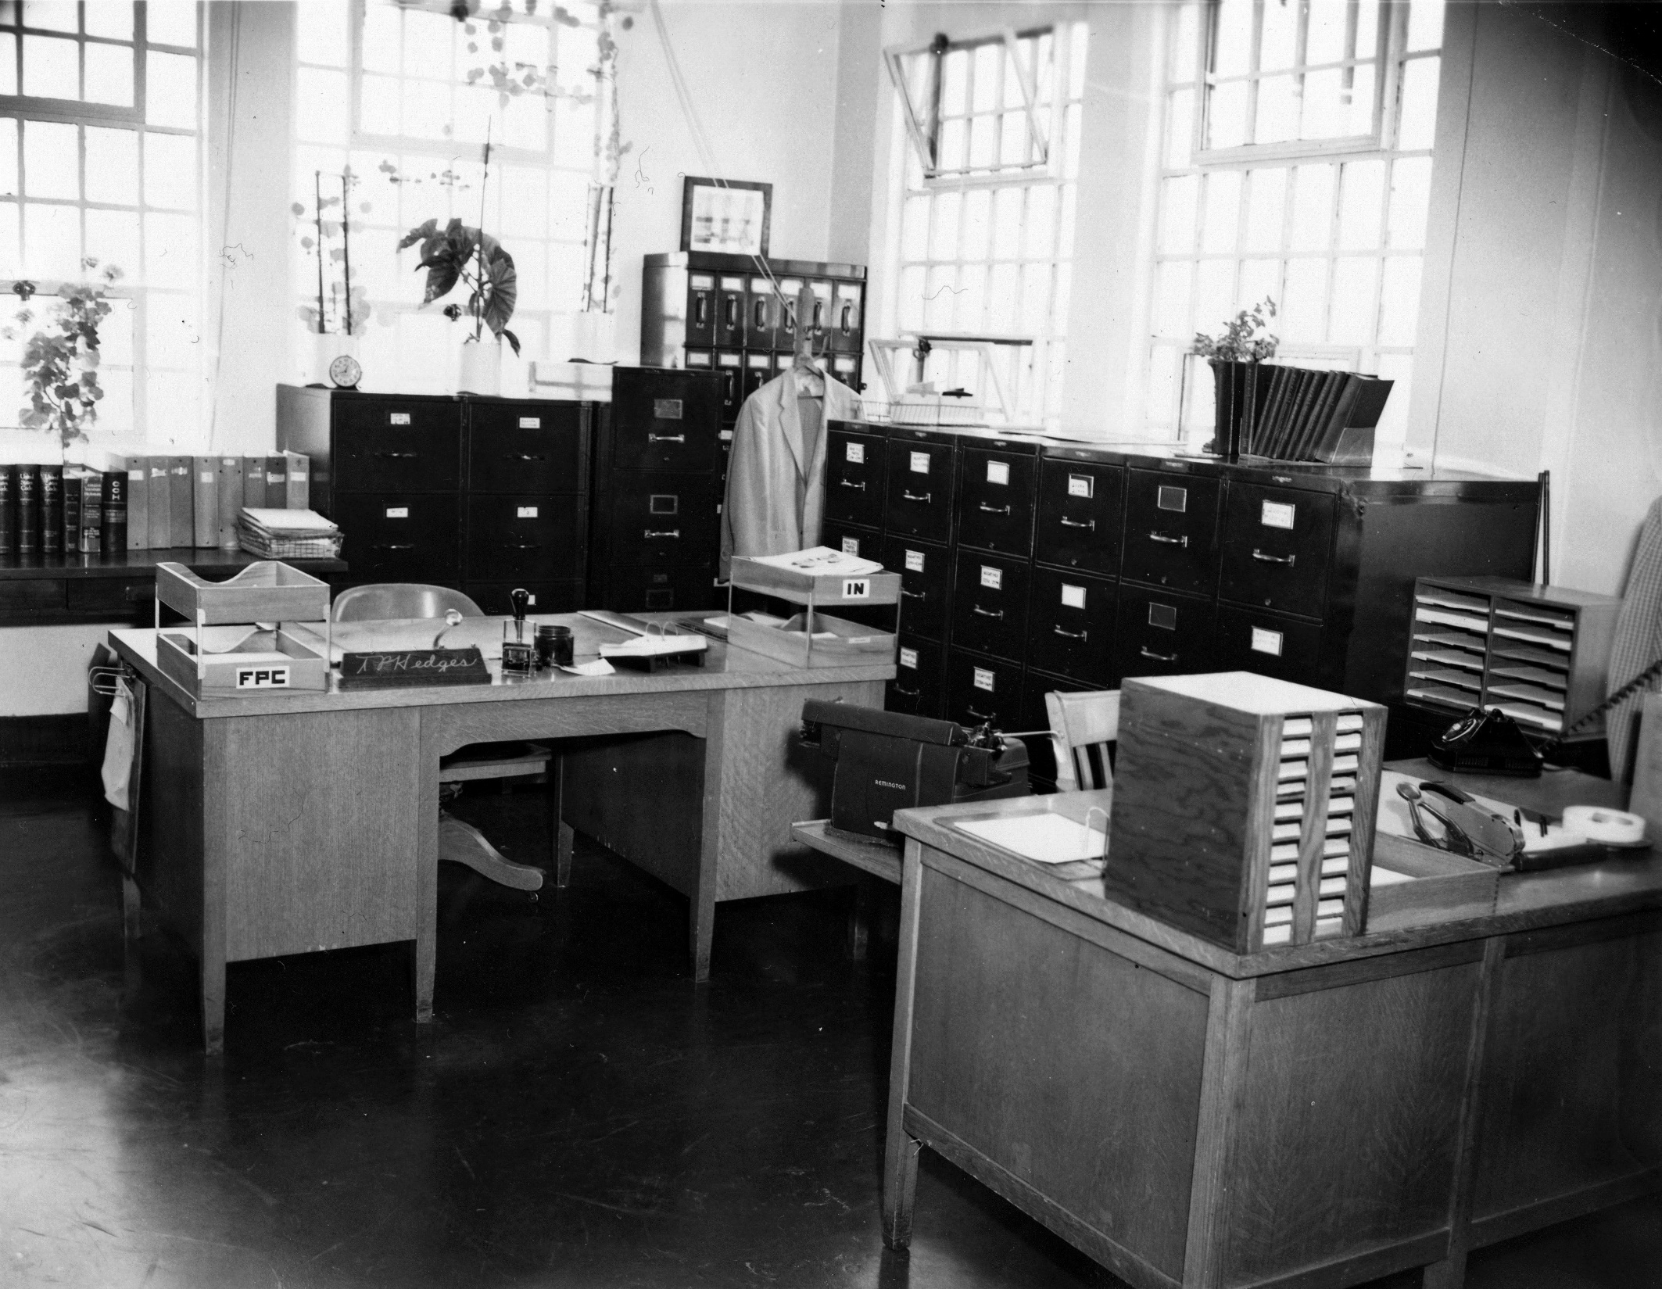

CREATE OR RECEIVE
* Recommended
Policies & Procedures
For managing records
assign responsibility,
Document policies & procedures,
train staff
* MRSC’s
Electronic
Records
Policy
Tool Kit
Department of Corrections, McNeil Island Corrections Center Photograph Collection, 1855-2010, Washington State Archives

Slide 6
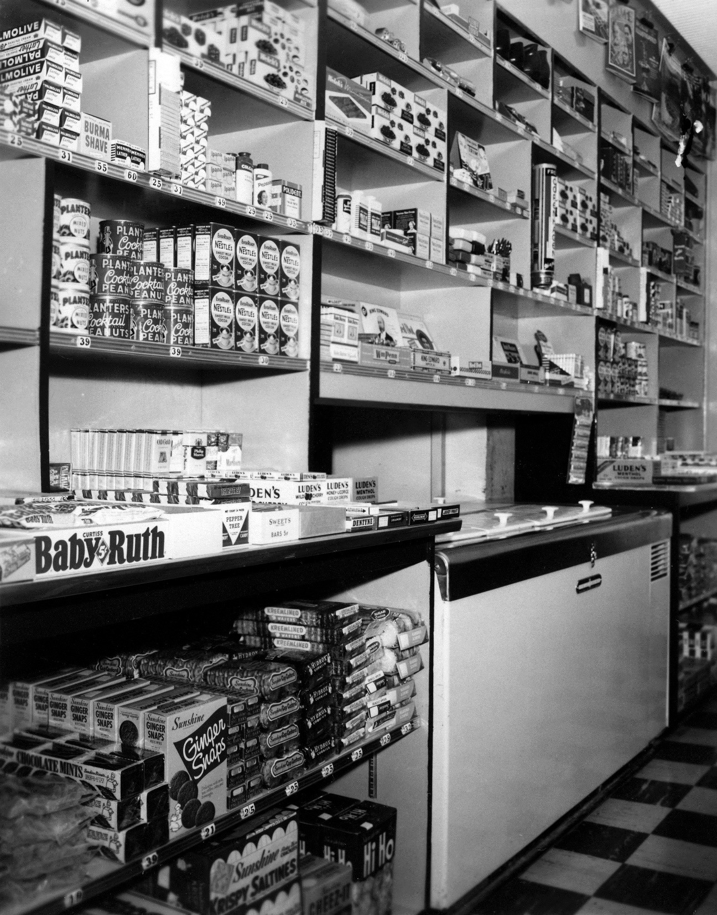

USE
organize records,
INVENTORY RECORDS,
Location | Brief Description | Inclusive Dates | Volume | DAN | Archival? | Essential? | Retention Period | Transfer/ Destroy Date | Confidential or Exempt?
Main Storage Room | Office supply receipts | 2004-2012 | 5 boxes | GS2011-184 | No | No | 6 yrs after EOFY | July-19 | No
Main Storage Room | Office supply receipts | 2013 | 1 box | GS2011-184 | No | No | 6 yrs after EOFY | July-19 | No
adopt tools
* MRSC’s PRA
& RECORDS MANAGEMENT
TECHNOLOGY GUIDE
Department of Corrections, McNeil Island Corrections Center Photograph Collection, 1855-2010, Washington State Archives

Slide 7
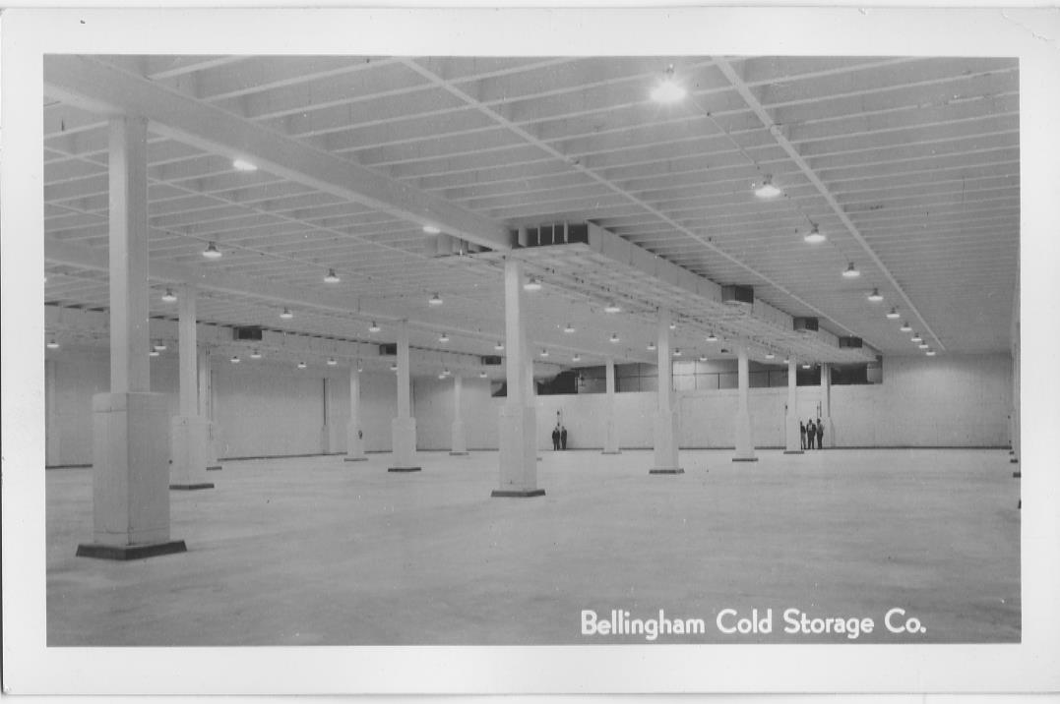
STORE
Understand retention requirements,
retain records in the appropriate format for the approved period of time,
and prepare essential records for possible disaster.
* WASHINGTON
STATE
ARCHIVES
Records of the Port of Bellingham, Photographs, 1890-1999, Washington State Archives

Slide 8
How do I know what to keep ?
Agencies are granted ongoing legal authority
to disposition (get rid of records) through legal documents called
records retention schedules
Records retention schedules for local or state government are
approved by the Local or State Records Committee
(RCW 40.14.060 and 40.14.070; chapters 434-624 and 434-630 WAC)

Slide 9
Which Schedule do I use ?
sos.wa.gov/archives
STATE AGENCIES (top navigation bar)
Records Retention Schedules (bolded link)
State General Schedule + Approved Agency Schedule
sos.wa.gov/archives
LOCAL GOVERNMENTS (top navigation bar)
Find your type of local government agency
CORE + Approved Sector Schedule(s)

Slide 10
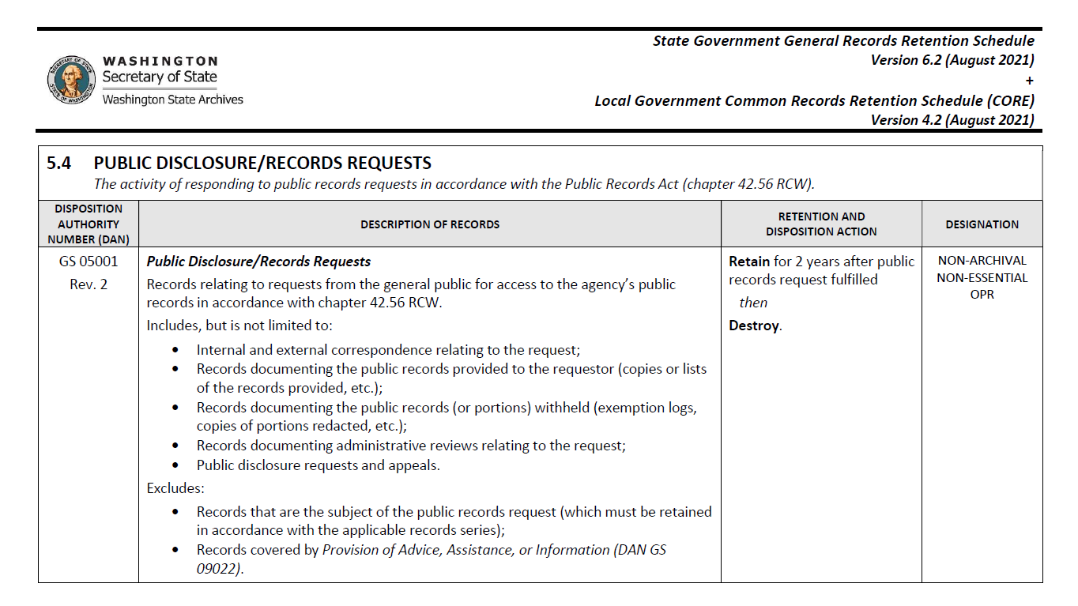

Records Retention Schedule
+

Slide 11
KEEP PUBLIC RECORDS FOR MINIMUM RETENTION
TRANSFER
then
DESTROY

Slide 12
What can I destroy now ?
Blank Forms & Publications Blank forms or extra copies of reports, brochures & newsletters. | Brainstorming Post-it notes, whiteboards, flipcharts, or staff notes from brainstorming sessions. | Contact Information Business cards, Outlook contacts, mailing lists, or mail returned as undeliverable.
Drafting & Editing Drafts, edits, comments, mockups from INTERNAL staff not needed as evidence of EXTERNAL consultation or due diligence. | Unsigned Digital Document Unsigned digital documents/templates for official business. | Spam & Mailers Advertisements, brochures, catalogs & newsletters NOT created by the agency.
FYI’s & Memo’s Cookies in the breakroom, sick notices, email read receipts, or out-of-office notices. | Browsing History Cookies, cache, temp files, saved credentials, Google searches, or bookmarks; excluding internet activity logs monitored by IT. | To-do Lists & Tasks Records monitoring work in progress.
RAW Data Captured Elsewhere Raw data or temp records (survey responses or written notes) documented by formal record. | Reference Info Materials gathered from outside sources for reference purposes. | Basic Agency Info Requests for hours of operation, contact information, web address.
Scheduling Invitations, checking availability, rescheduling, and venue arrangements. | Secondary Copies Printouts of database records, webpages, emails, convenience copies. | Unsolicited Info Information not requested or used by the agency.
* TRANSITORY RECORDS CHEAT SHEET

Slide 13
hold it !
There are times when you must hang on to records even if their retention requirements have been met:
  Litigation holds (must keep until hold lifted)
  Open public records requests (must keep related responsive documents until request fulfilled/closed)

Slide 14
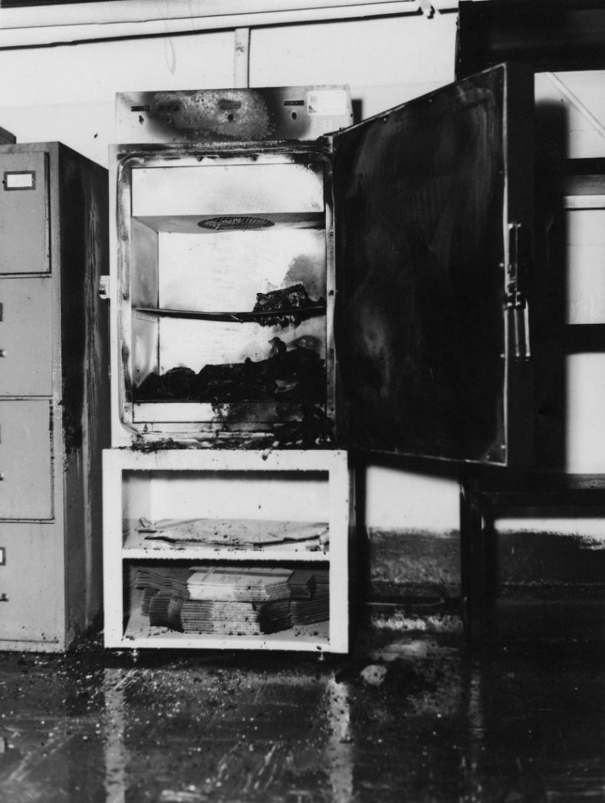
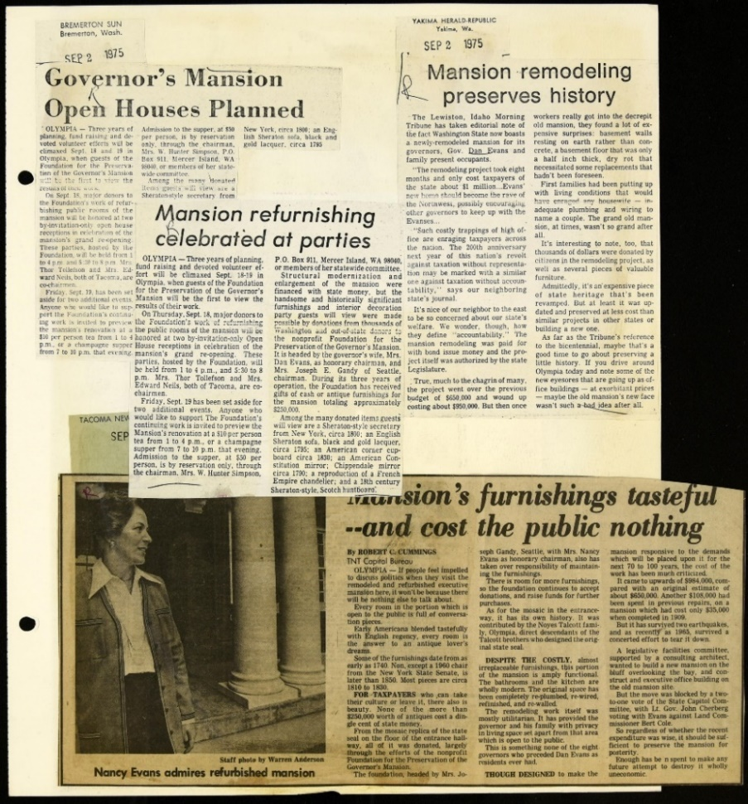
Destroy or Preserve
* Sample
Destruction
Log
Department of Corrections, McNeil Island Corrections Center Photograph Collection, 1855-2010, Washington State Archives
Governor Daniel J. Evans, Jan. – Dec. 1975, Daniel J. Evans Scrapbooks, Washington State Archives

Slide 15
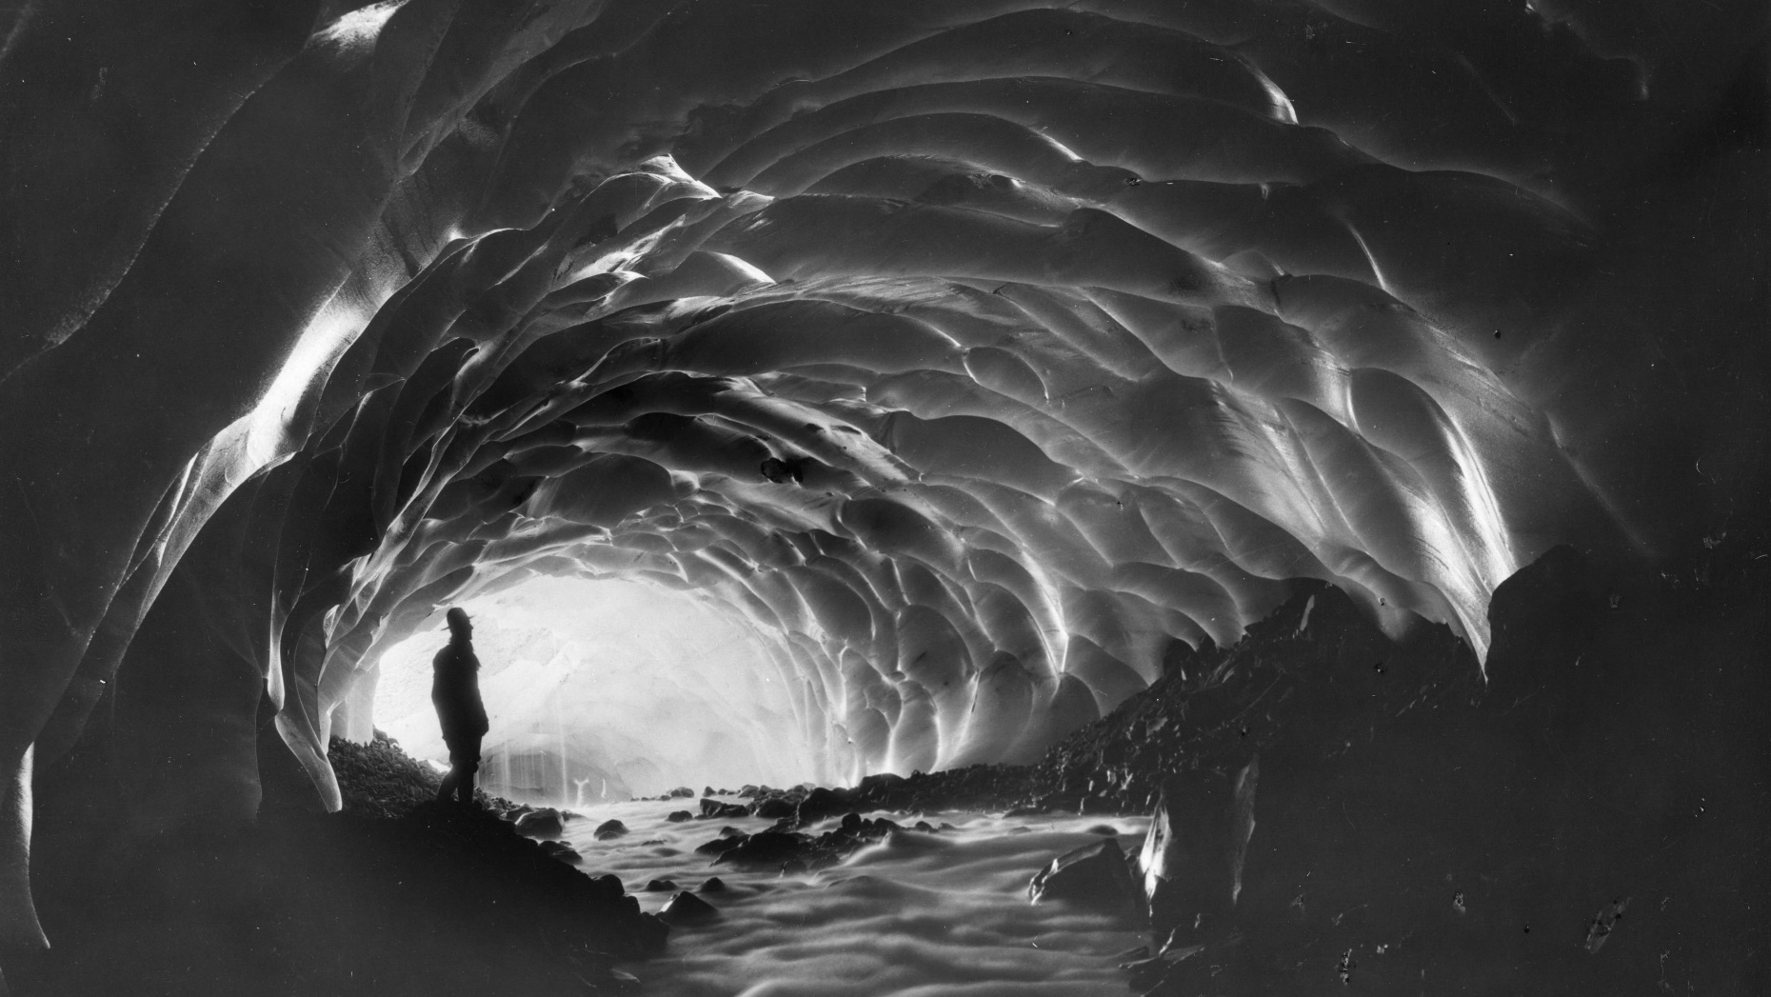
additional resources
Don’t get lost in a cave; the RECORDS MANAGEMENT TEAM is here for you with free consultation, training, & advice.
www.sos.wa.gov/archives
recordsmanagement@sos.wa.gov
(360) 586-4901

