Slide 1
Searching in M365
Notes:
High level overview of what electronic searching looks like in Microsoft 365.

Slide 2
Disclaimer
Following is based on our experience and current understanding
    Things change quickly with Microsoft
DOC and DFW are licensed at the E5/G5 level and are members of the Washington State Shared Tenant.
Consider your organization’s current setup
    Are you in a commercial or government tenant?
    What is your license level?
Notes:
Opinions expressed within this presentation are not representative of all experiences.
We include advice based on our personal experience, current licensing level, and the settings in our shared tenant.
- Different agencies may have access to a different type of tenant or be restricted to a lower licensing level
- DOC and DFW are both members of the WA State Shared tenant – which includes roughly 60 government agencies

Slide 3
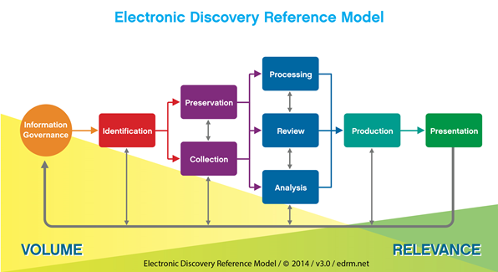
What is eDiscovery?
Electronic discovery – identify and deliver electronic information/records for use in a public records request or as evidence in a legal case.
Electronic Discovery Reference Model (EDRM) –
Notes:
Electronic Discovery or eDiscovery – process of identifying and delivering electronic information/ records that can be used as evidence in a legal case or provided in response to a records request.
EDRM – Start with the most records on the left, and the least amount of relevance and cull down hits as you work each case.
I will focus on preservation through processing
Kelly will touch on review, analysis and production
Erin will discuss steps in production and presentation

Slide 4
What can be gathered in M365?
Exchange Online (EXO)
Emails, calendar, tasks, notes, contacts
Teams
1:N chat and meetings
Channel posts
OneDrive
Personal – staff specific documents
Documents shared in chat or linked in email from OneDrive
1:N Meeting recordings
SharePoint
Group or project records
Team channel Meeting recordings
(stored in EXO)
Notes:
There are A LOT of different applications connected to M365!
These are the big four that almost all customers will use regardless of license level.
EXO – most staff just think of this as Outlook
Teams
OD –
SPO

Slide 5
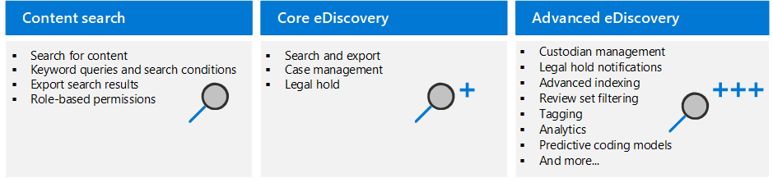
Three types of searches
M365 has three different types of eDiscovery searches
  DOC and DFW primarily use Advanced eDiscovery (AeD)
Notes:
Three different types of searches.
We use AeD for most cases because it provides more features.
Your licensing level determines what you can do
We do not use content search because the searches are visible to other agencies in our tenant – it may be a good fit for others

Slide 6
Pros and Cons of Core
PRO
Better for simple large exports
Good if you don’t need refined review
Can be used with a lower license
Can be used to place holds
CON
No case management options
More limitations on the number of items that can be previewed
Notes:
Enabled at the E3/G3 license level
Core is a very effective tool that we do use from time to time.
- We use Core when you are doing a simple search that does not necessarily benefit from reviewing the records or keeping the case open for an extended time

Slide 7
Pros and Cons of Advanced
PRO
Adds review functionality
Conversation reconstruction (Teams chat)
Adds export options (native & load file)
Adds Hold notifications
CON
More complicated than Core
Requires a higher license
More frequent updates
Notes:
We primarily use AeD. AeD requires an E5/G5 license or an advanced search module.
At DOC most of our searches are large and are organization wide. We need the ability to review records and cull down hits
- Conversation reconstruction was also a big selling point for us because we were concerned about the work that would be required to piece together a Teams chat
We are still working on ways to use AeD for more than just eDiscovery
- Litigation hold functionality
- Cyber Security uses
- auditing retention
AeD is subject to more frequent updates and changes because it is newer. It has been difficult to map old training processes onto AeD

Slide 8
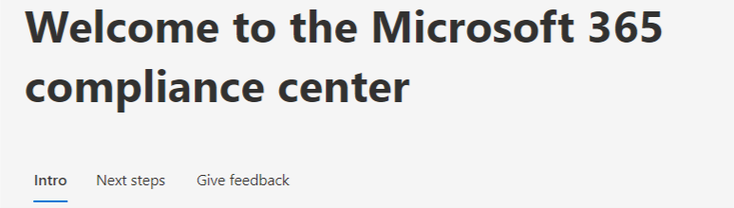
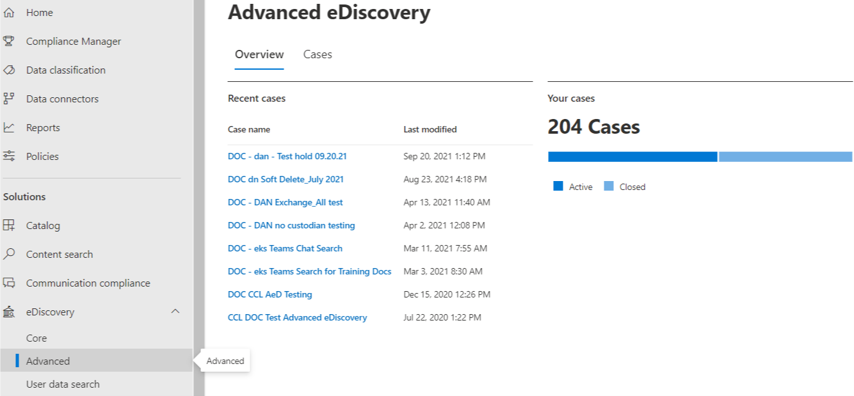
Making a new case
Microsoft Compliance - https://compliance.microsoft.com/homepage
  Home page for most admin settings: Info protection, Records Management, Policies, etc.
eDiscovery > Advanced > Cases > Create a case
  Cases need a unique naming convention across your tenant
  We use agency abbreviation and searcher initials
Notes:
Everything starts with the compliance center
- Most Admin functions for different groups in your agency start here
- your permissions determine what you can see and access
To create a new case find the eDiscovery topic on the left hand side – expand it and choose Advanced
- this opens up your case overview which will show you all active cases that you have access to
- Every case in your tenant needs a unique name
- We use agency abbreviation and searcher initials

Slide 9
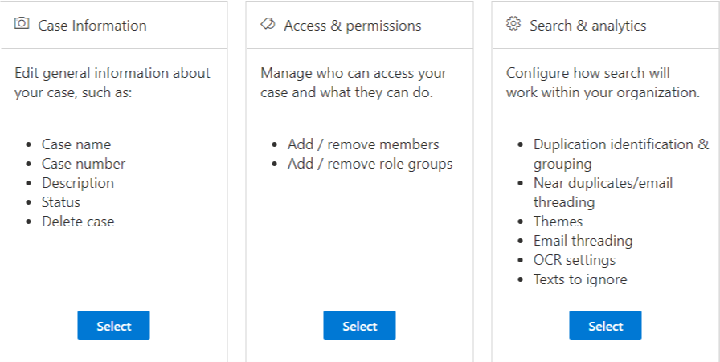
Case settings
After creating your case you should review your settings
  Add other searchers in your organization who may need access – by staff or by role group
  Change case name and add a description
  Delete an old case or one made in error
Set permissions based on need – pick and choose roles
  Reviewer – only have access to review
  eDiscovery Manager – all case management abilities
  eDiscovery Admin – Can see and edit all cases across the organization
  More info on permissions here: https://docs.microsoft.com/en-us/microsoft-365/compliance/assign-ediscovery-permissions?view=o365-worldwide
Choose analytics settings
We use 100% de-duplication
Notes:
Review settings:
- this is where you can add the other searchers and reviewers so they can find the case.
- You can edit the basic information about the case and add a more detailed description
Permissions
- Permissions are run with Azure Role Based Access Control (RBAC)
- Default you have Reviewer, Manager and Admin
- You may need to create new roles if you are in a shared tenant

Slide 10
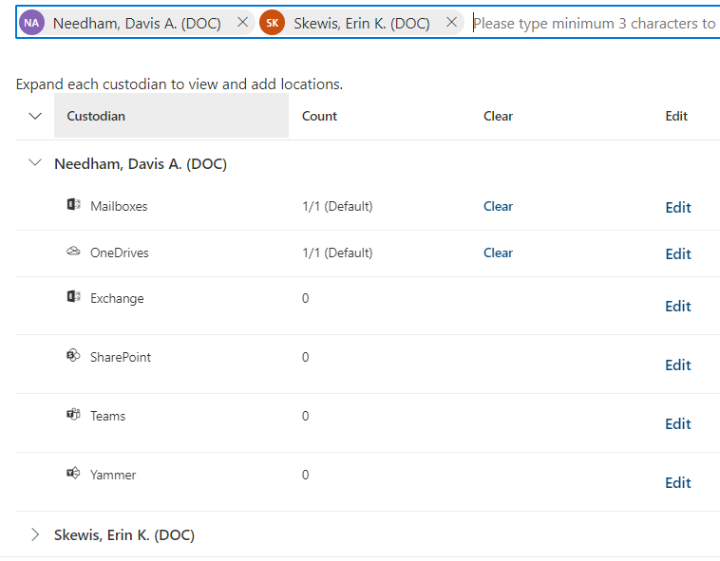
What are you looking for?
Can your search be narrowed?
You can search by specific locations or by custodian (staff)
  Find staff based on active directory
  Search mailboxes, OneDrives, 365 Groups
  You will need another tool for gathering SharePoint URLs
  You can import custodians in bulk using a template
Search terms anywhere
  Most of our searches at DOC involve agency wide search terms without custodians
Notes:
Now that you have a case created and the settings established
- What are you looking for with your search? Set you Data Locations
- The tool is geared toward searching by custodian (staff) or by specific location.
- In line with the EDRM – AeD wants you to ID what you want to search – place your holds then run the actual search
- we rarely follow the EDRM exactly at DOC
- Add staff based on your organization’s AD. You will need a way to find SharePoint pages for your org
- IF you have a lot of custodians to add you can use an upload template
- More common for us because of the types of broad requests we get - is to run searches across entire areas (all email/OD/Teams)

Slide 11
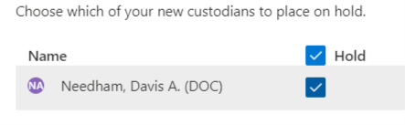
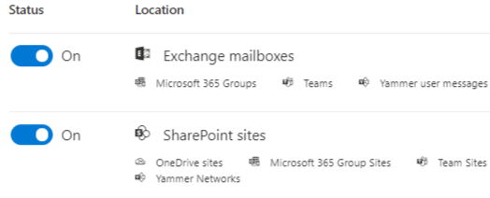
To hold or not to hold?
If you identified custodians for your case you can place them on hold
  Custodial holds affect email and OneDrive locations
  You can choose which custodians to place on hold
No custodians? You can use the Hold tab to place specific mailboxes and sites on hold
  You can lookup staff from AD
  You will need the actual site URL to place a site hold
You can use the Hold tab to place specific terms on hold
  Topic based vs user based
  Using keywords will place those terms on hold in the locations selected.
  Use a timeframe or the hold will continue to run on new records
Notes:
Both Core and Advanced allow you to place holds
Placing a hold is NOT the same as searching the items. All it is doing is preventing the records from being lost due to manual deletion or when records have met their set retention. In order to search and process what is preserved you will need to create a collection.
We often place our holds after running initial searches to make sure we are getting what we expect and limit the impacts of holds.
We have more topic based holds than user based.
A hold without a timeframe will continue to be applied to the areas you included. This is okay in response to litigation, but if you are placing holds for public records requests you likely only need records up to a certain date.
With Advanced you gain the ability to issue hold notifications to staff. This way you can communicate to all of the staff you are placing on hold at once to let them know they need to preserve their records and that deletion will be prevented. Your communication can include a link to acknowledge the hold, timed reminders, and notifcaiton when the hold is lifted

Slide 12
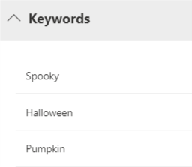
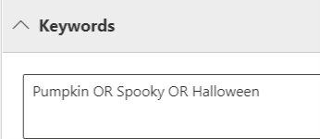
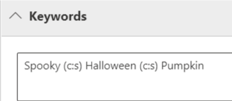
Collections: Keyword searching
In Core you run searches, in Advanced you run collections
If you added custodians to your case you can quickly pick from their locations in a new collection
  In Core you can only search by location, not by custodian
  There are a LOT of different ways to setup your searches
  below examples are searching for the same thing in different ways
  Keyword queries article is your friend! https://docs.microsoft.com/en-us/microsoft-365/compliance/keyword-queries-and-search-conditions?view=o365-worldwide
Notes:
When using AeD it is best to create your collection as a draft before committing it to review
- This will avoid unnecessary errors if your search does not return any hits
- Gives you the ability to look at the search preview and statistics to see if you are getting what you expect before committing it to review

Slide 13

Search conditions
Date | Sender/Author | Size (in bytes) | Subject/Title
Retention label | Message Kind | Participants | Type
Received | Recipients | Sender | Sent
Subject | To | Author | Title
Created | Last Modified | File Type
There are 19 different search conditions available in the system.
  There are more attributes you can search by, but they must be typed in as separate keywords
  More information about the conditions for different types of records can be found in in MS help documentation:
Notes:
With all of the connected applications for M365 there is a ton of metadata that you can use to construct your searches
As of last week there was 19 conditions available within the AeD user interface that I could use in a search.
There are more things you can search on, but you must know them and write them in manually – like the example above with “has attachment”

Slide 14
What is not discoverable?
Not all applications connected to M365 are fully discoverable!
In our tenant we cannot fully search the following:
Work with your architecture/ IT team to identify which apps are in use and what is on your organization’s roadmap
If not in one of the big four its probably missing!
Bookings | MyAnalytics
Delve | Planner
Flow | PowerApps
Kaizala | Power BI
Lists | Teams Voicemail Transcripts
Education | Whiteboard
Notes:
Unfortunately not everything is centrally searchable using eDiscovery
Table is an example of things we currently have issues fully searching
- This will vary depending on your tenant settings a bit
IF you already have an governance and IT group that reviews potential software before it is approved, that is a great place to start. – Collaboration is more important than ever!
- The Records management and Disclosure groups should have a larger role in what their agencies choose to use

Slide 15

Reminders
Your agency may need a universal searcher
  More risk to have your staff search things that might be hidden from their view
Different experience in Government vs Commercial and shared vs private tenant
Dynamic platform
  Updates are regular and sometimes are not announced in advance
  Difficult to have a screen shot based training
Training is important
  Search logic – learn Boolean operators
  PowerShell – more and more functions
Search limitations
  Errors happen – refresh and restart
  No way to monitor other ongoing searches
Notes:
Finally here are some general warnings and reminders

Slide 16
Basic Tips for Reviewing Records in Advanced eDiscovery in O365

Slide 17
Some basic tips before you begin reviewing in Advanced eDiscovery
Be sure to use Microsoft Edge for review since other web browsers will not allow you to export files.
If you have access to a virtual server it is recommended to use that for review. That way it will not cause lagging on your machine with reviewing and downloading.
If you do not have a PST converter it is recommended to get one since that is the best way to download records from the system.
Lastly, be sure that all of your reviewers have the correct permissions so that they are able to Review, Tag and Export.
Reviewers will need more training and guidance.

Slide 18
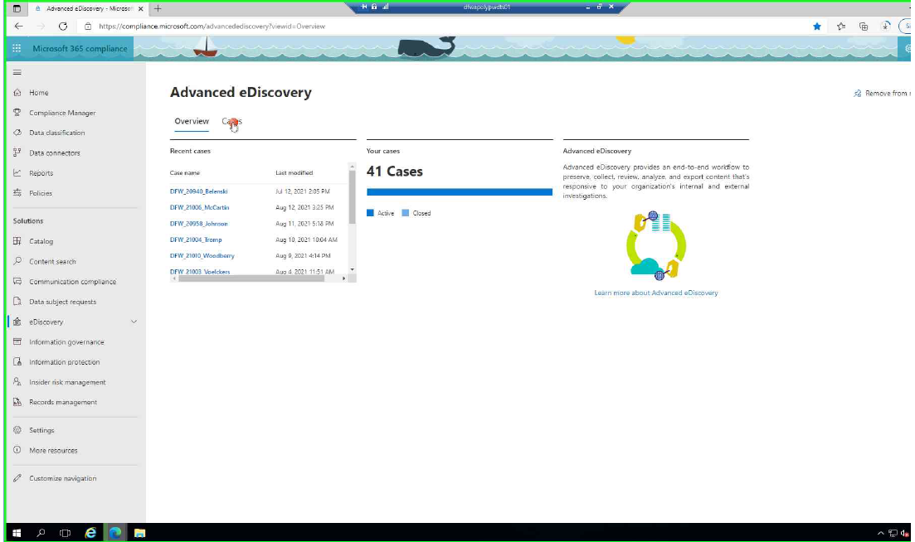
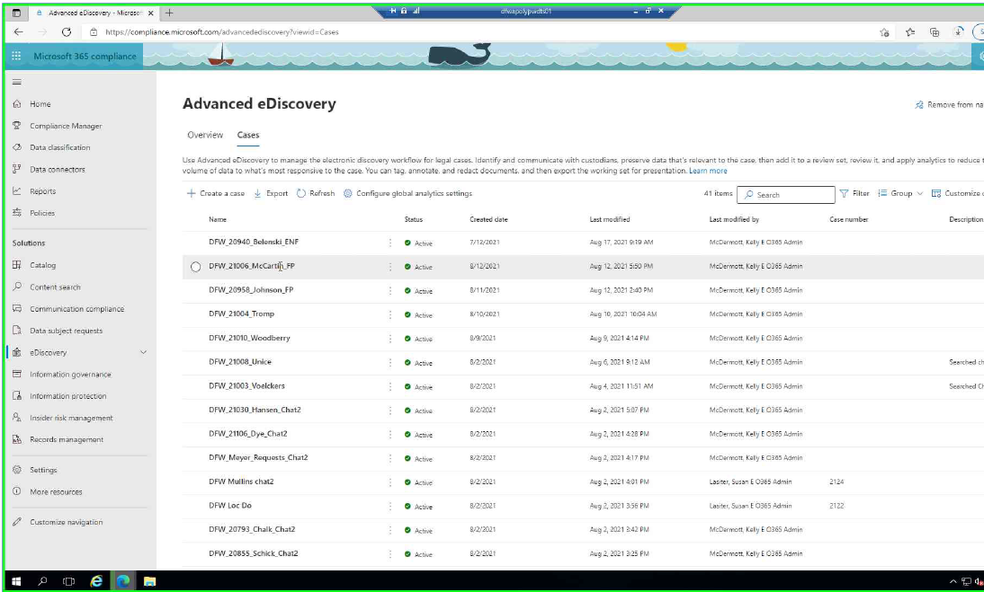
When you first log into Advanced eDiscovery it will take you to an Overview section which will list your recent cases and how many active and closed cases you have.
You can view a list of all cases by going to the “Cases” tab.

Slide 19
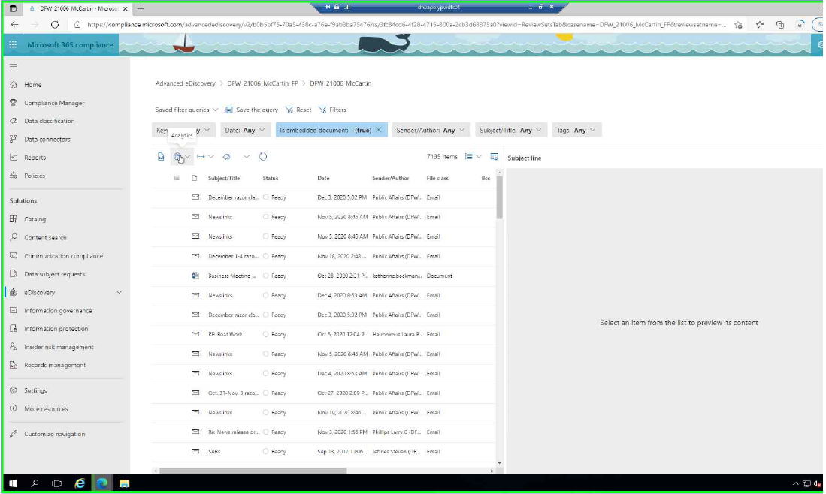
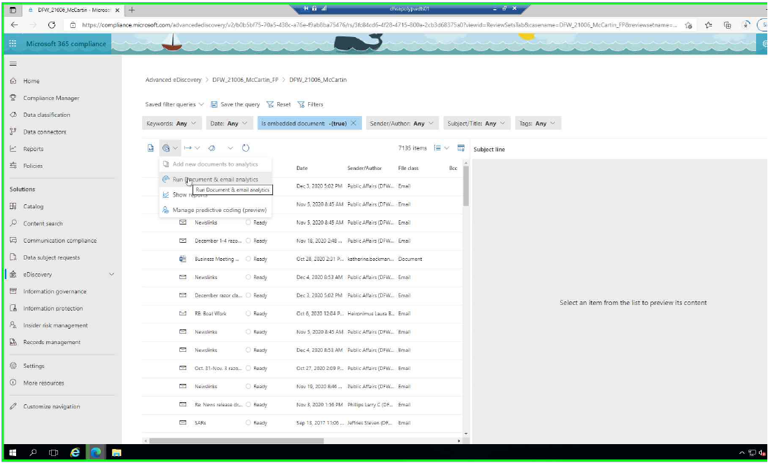
If you are wanting to use analytics to review conversation threads and remove duplicates, I recommend running it before you begin your review. This does take time so be sure to check to see if it is completed in the jobs tab before you begin your review.
  Note you can change the Near duplicate threshold in Settings

Slide 20
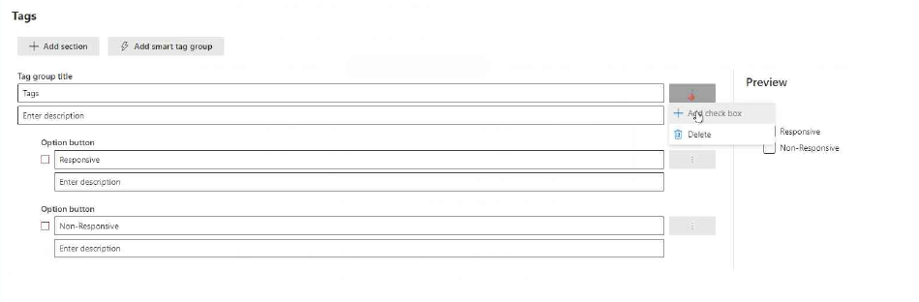
Tagging
Since the Tags cannot be saved outside of a single search. I found that the best way to be consistent is to create the tags for the reviewer after the search is completed. That way each search is using the same Tags.
I also create all Tags as check boxes so that if something is accidentally tagged it is easier to change since all you need to do is uncheck that tag and click apply. If you select the “option button” you cannot unselect once it is selected.

Slide 21
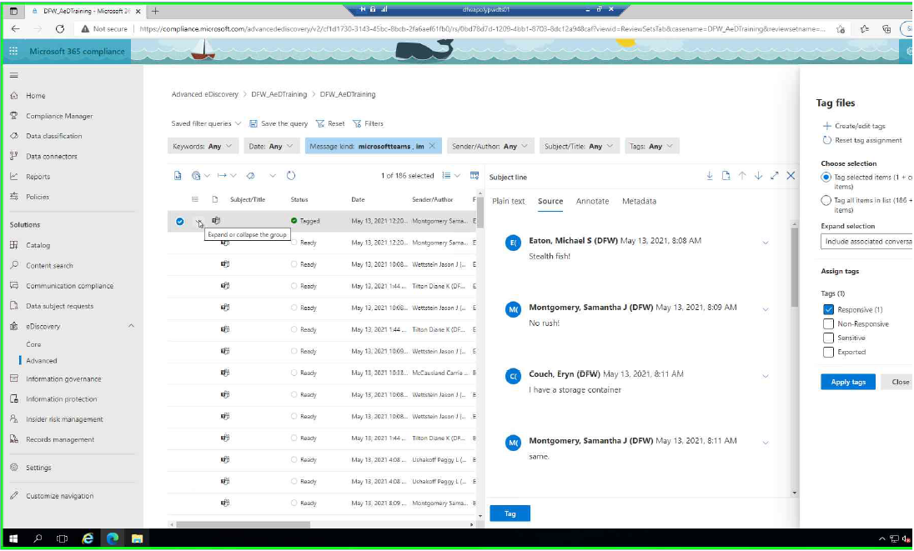
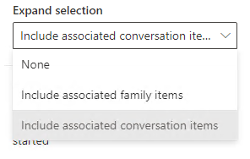

When tagging files a few things to note:
  If you are reviewing and tagging messages, be sure that the “Expand selection” is “Include associated conversation items” to tag all messages with the same tag.
  If you are reviewing and tagging emails and documents, be sure that the “Expand selection” is “Include associated family items” so all attachments associated with an email are also tagged the same.
  Also be sure that the “Tag selected items” is selected and not “Tag all items in list.” If you select items in list, it will tag all records at once and there is no way to stop it once that happens. However, if you are using the check box tag you can go in an unselect the check box for that tag once the job is completed.
  If you only want to Tag the one message or one email/document, you will want to select “None” in the “Expand selection”

Slide 22
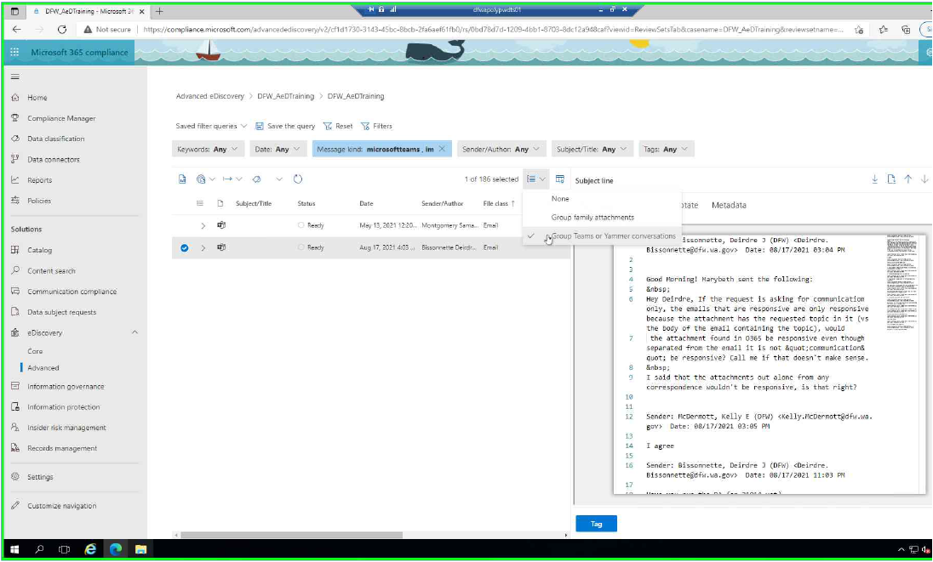
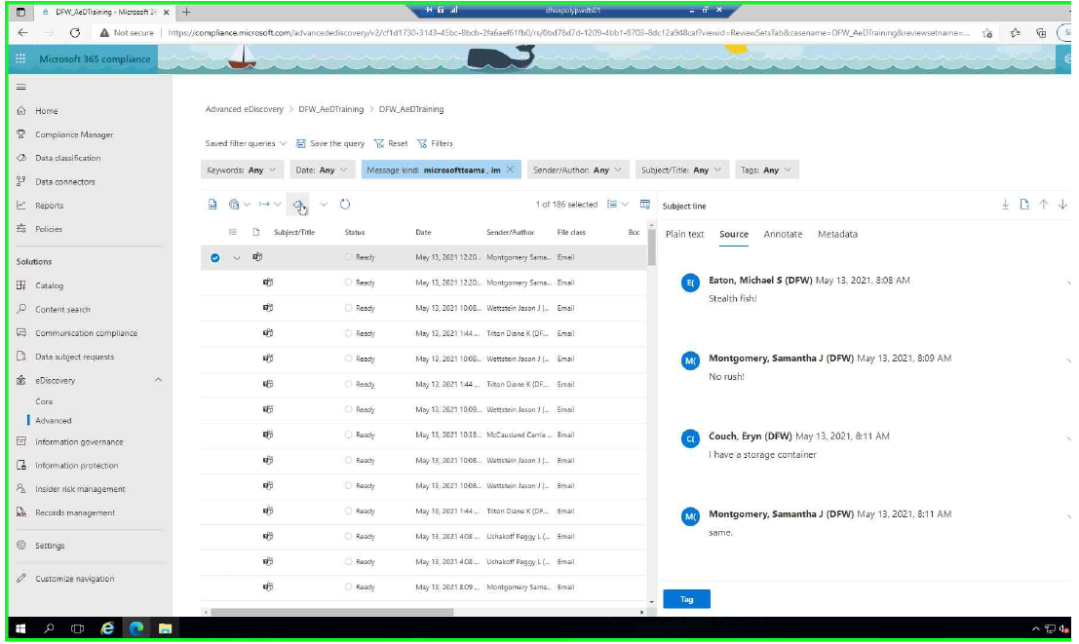
Filters
  I have found four filters that really work for us in reviewing records.
  To save a filter in a review set click “Save the query.”
  The first I have created I titled “Chat Review.” I created this by selected the “Message Kind” filter and selecting microsoftteams and IM as the filter. Also be sure that the Grouping is set to “Group Teams or Yammer conversations.” This allows you to review chat threads seamlessly and all at once.
  Another tip is to review the chat messages in an online format I recommend selecting “Source” in the Preview pane. This allows for easy scrolling through the message thread.

Slide 23
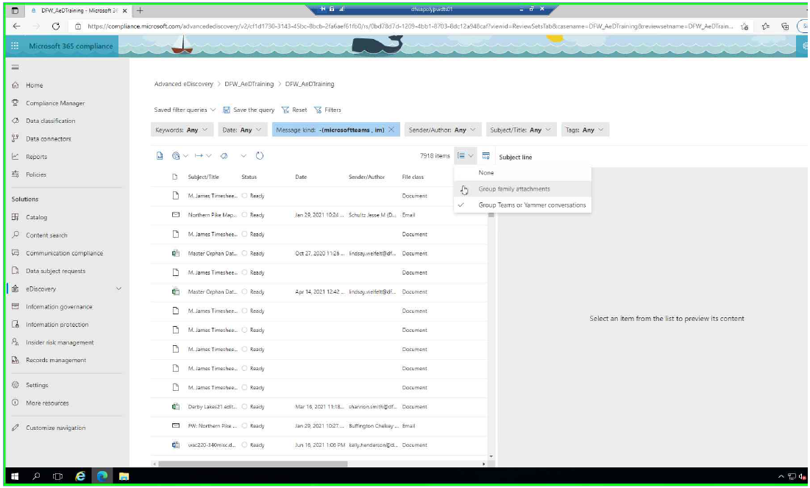
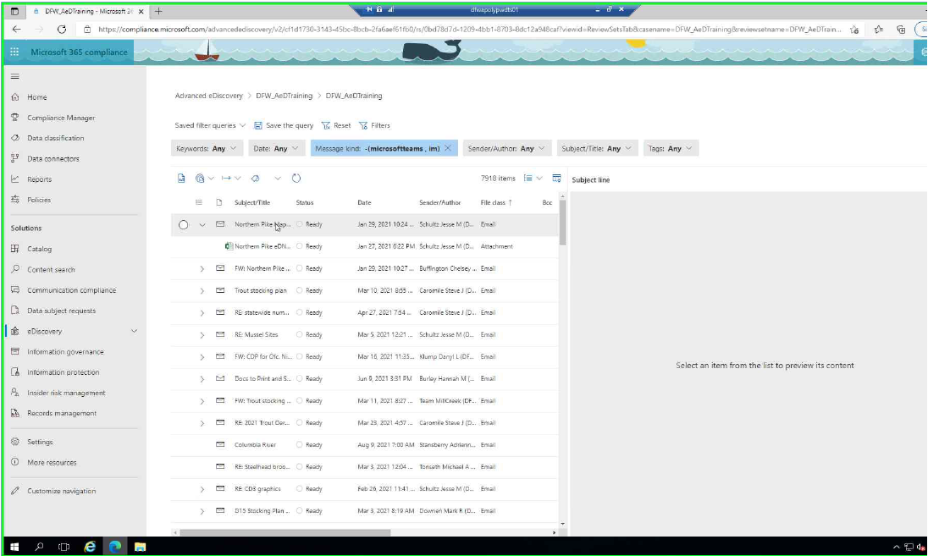
  The second filter I have created I titled “Email and Doc Review”
  This filter was created to make it easier for Email and Document reviewing. I created this by excluding microsoftteams and IM from the review and then selecting “Group family attachments.” This allows for easy reviewing of email with attachments because it nests the attachments under the parent email.

Slide 24
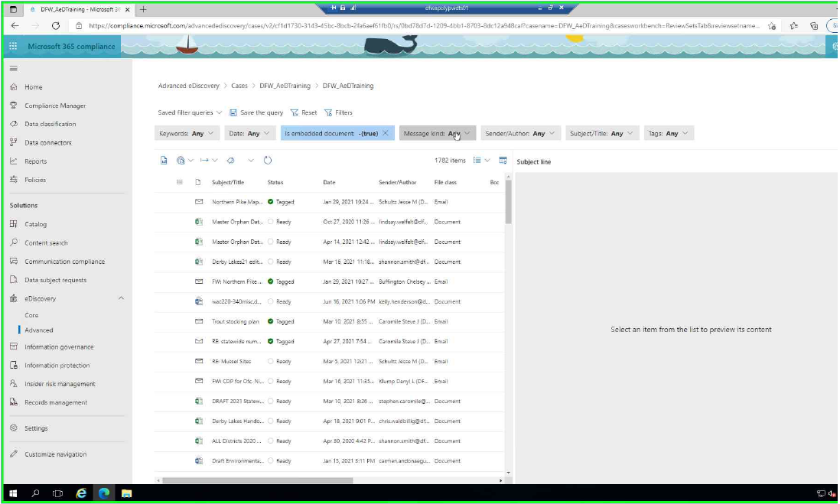
  The third filter I use I have titled “Export View”
  This filter removes the email attachments from view so you can easily filter for export.
  You can do this by selecting “Is embedded document” and selecting “False”

Slide 25
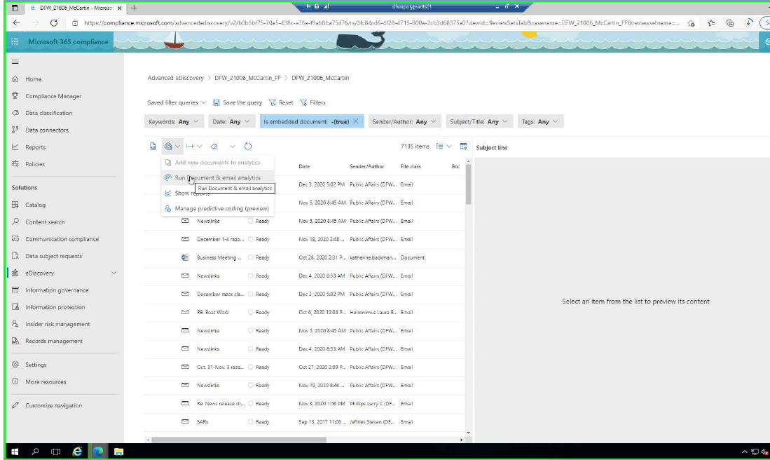
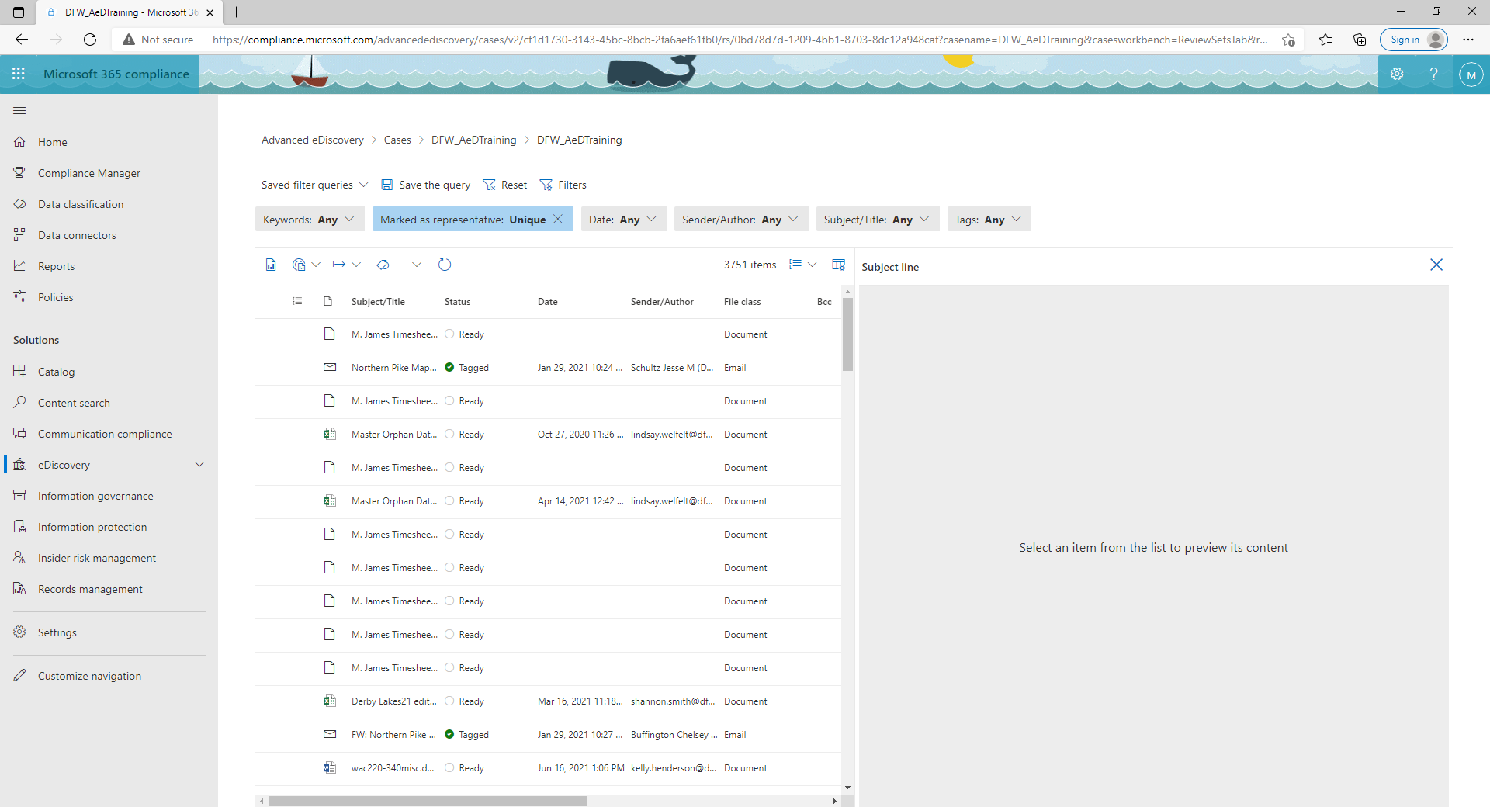
  The fourth filter I have created I titled “Deduping Filter.” I created this by first running analytics on the review page and then selecting the “Marked as representative” filter and selecting “Unique.”
  This excludes duplicates from view so you can review only the unique records in the review set.

Slide 26
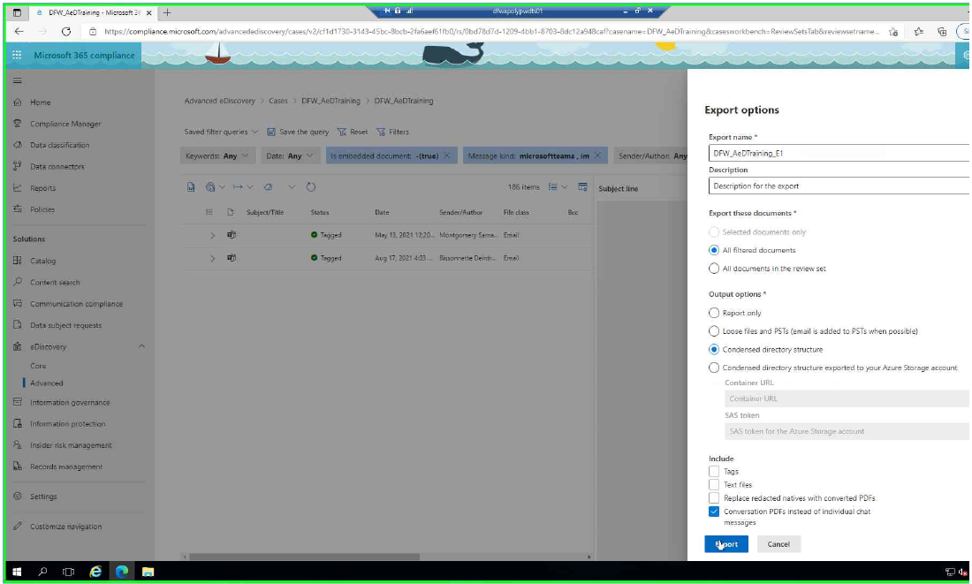
  When exporting it was recommended for us to export by message type so that you can keep the message thread together and also export the chat into a PDF if you want to keep the chat together.
  To export chat message thread into a PDF you select the Output options “Condensed directory structure” then select Include “Conversation PDF’s instead of individual chat messages.”

Slide 27
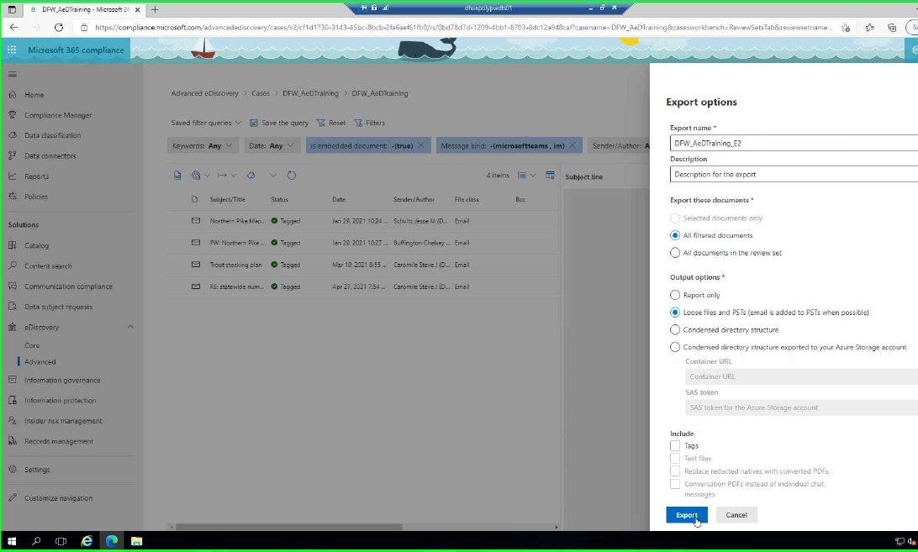
  To export email and documents we export by selecting Output Options “Loose Files and PST’s”
  This will export the emails into PSTs by staff member and export the documents by staff member or team.

Slide 28
Email, PST and MSG Converter Programs
There are a lot of options out there, but none of them seem to be “the perfect product”
Determine what features are most important to you/your agency.
For the programs on the next slide, most of them have a free demo version available on their website.
Recommended to use a demo version before purchasing
DOC is currently using Evermap Auto-Portfolio Plug-In, but is looking into new software due to issues with the Evermap software.

Slide 29



 | Evermap Auto Portfolio (DOC Currently Uses) | Bitrecover PST to PDF Wizard PRO | Sperry Save as PDF PRO | DRS PST File Converter | Total Mail Converter Pro (DFW Currently Uses)
Converts email and Attachments to PDF
Converts multiple PST files at once
Converts emails into one PDF
Once license can be used on multiple machines*
Converts calendar items
One time payment (lifetime license)
*Evermap – One license can be used on different machines, but it has caused some issues for DOC.
*Total Converter Pro – Only certain levels of licensing (at different prices) allow use of licenses on multiple machines
Notes:
PST File Converter Tool to Export PST File into 10+ Formats (data-recovery-solutions.com)
Save As PDF Add-In - Easily Convert Emails to PDF (sperrysoftware.com)
PST to PDF Converter to Export Emails from Outlook to PDF Adobe in Batch (bitrecover.com)
AutoPortfolio™ Plug-in for Adobe® Acrobat® - convert, extract and manage PDF Portfolios (evermap.com)
Unique Total Mail Converter Pro 11.0 (coolutils.com)

