Slide 1

Welcome to the
WAPRO 2021 Annual Business Meeting

Slide 2
Session 1C
Annual WAPRO Business Meeting
11:30 am – 12:00 pm
WAPRO Board
Jenny Hallengren-Sawyer, President
Tracy Becht, President-Elect
Debbie Hamilton, Vice President
Tyler Entrekin, Treasurer
JamieLynn Estell, Secretary
Brian Lewis, Director
Luara Baseler, Director
Matthew Jaeger, Director
Karen Horowitz, Director
Session 1C:
Dial In 1-253-215-8782
Webinar ID: 88501116 9390
Passcode: 340566

Slide 3

Meet the WAPRO Executive Board:
  President:
    Jenny Hallengren-Sawyer
  President Elect:
    Tracy Becht
  Vice-President:
    Debbie Hamilton
  Treasurer:
    Tyler Entrekin
  Secretary:
    JamieLynn Estell
  Directors:
    Brian Lewis
    Luara Baseler
    Karen Horowitz
    Matthew Jaeger

Slide 4
Thank you to our wonderful
WAPRO Committee Volunteers!!!
Certification Committee
Communications Committee
Training & Development Committee
Policies & Procedures Committee
Thank you!!
Thank you!!
Thank you!!

Slide 5
Thank you to the wonderful
1,385 WAPRO MEMBERS!!
Thank you!!
Thank you to the Fabulous Presenters!!
Thank you AMI!!
You have all helped make this important work happen.
Thank you!!

Slide 6
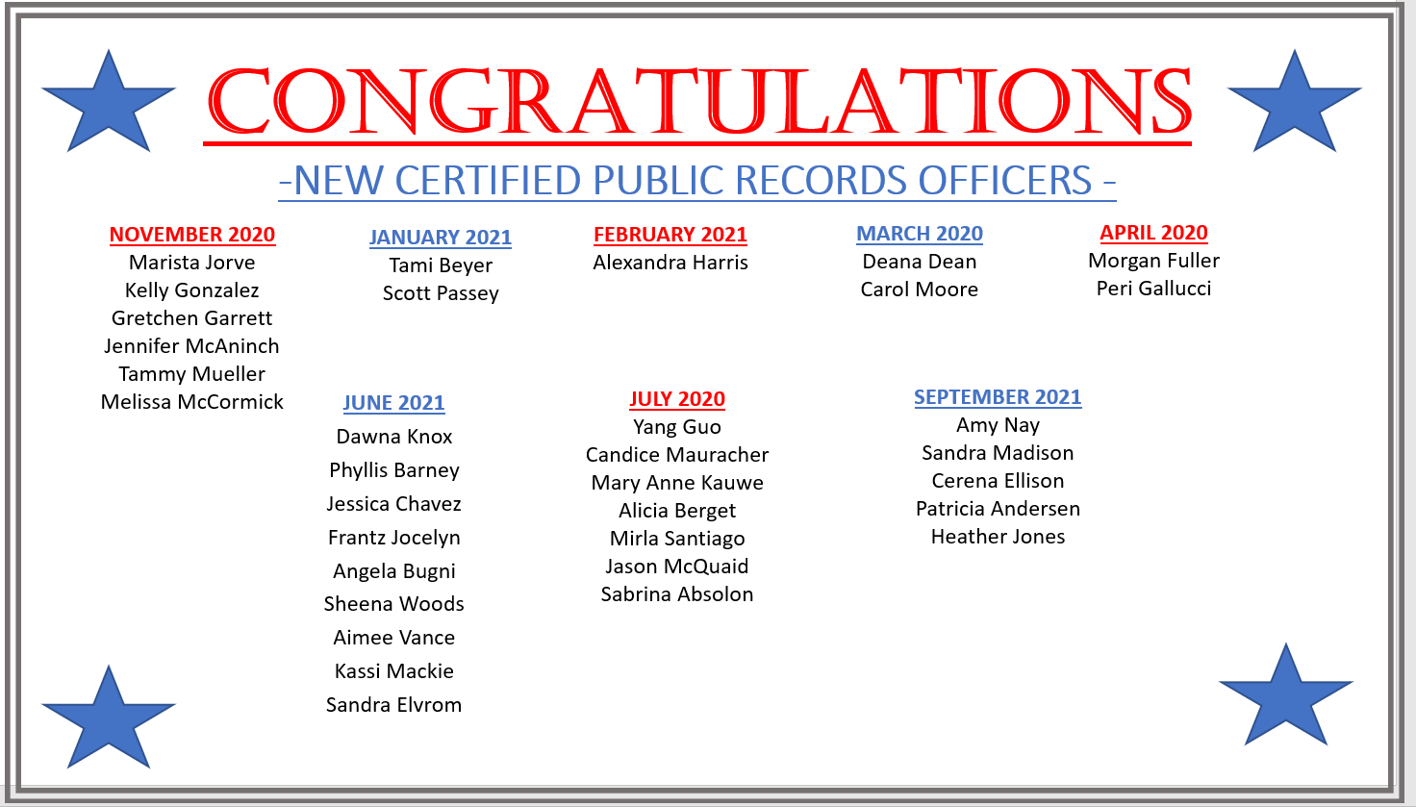

Slide 7
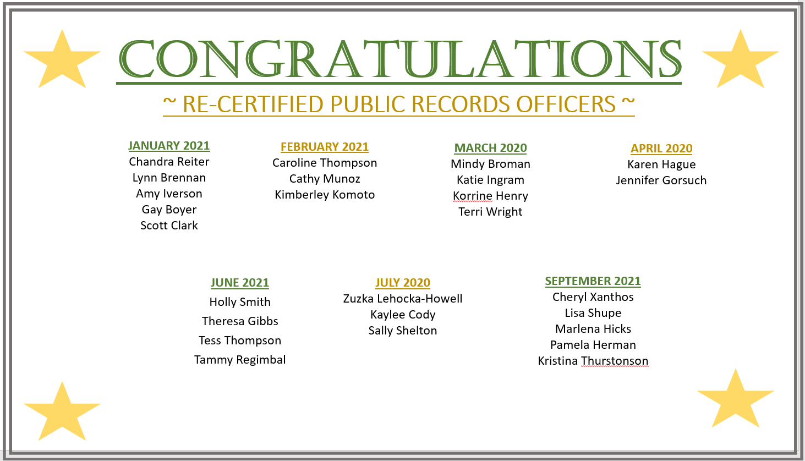

Slide 8
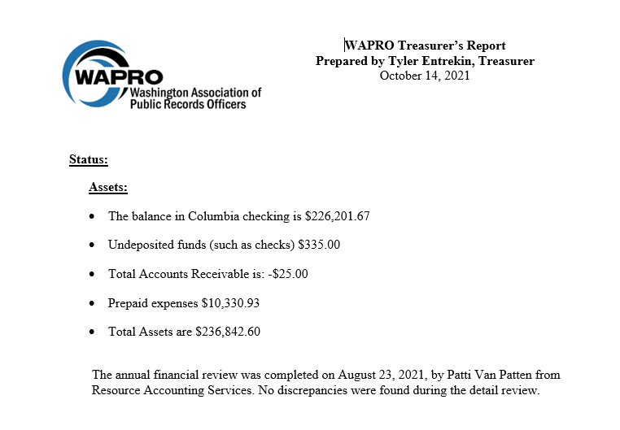
Treasurer’s Report

Slide 9
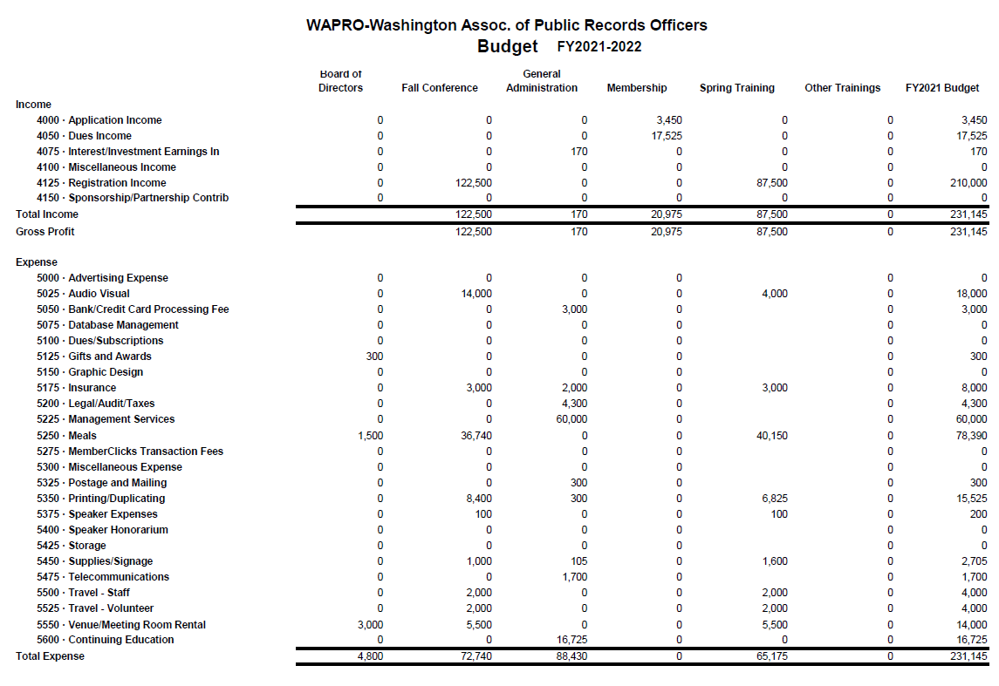
Proposed 2021-2022 Budget

Slide 10
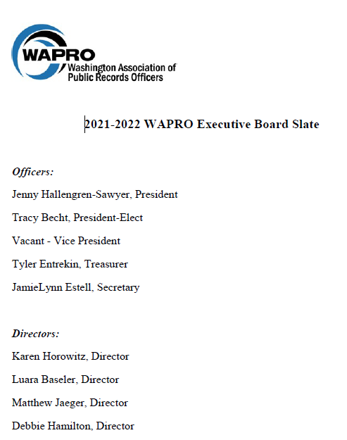
2021-20212
WAPRO
Board Slate

Slide 11
2022 WAPRO CONFERENCES
Mark Your Calendar
Spring Conference
  Lynnwood Convention Center
  Lynnwood, WA
    May 12, 2022
Fall & Annual Business Meeting
  Tacoma Convention Center
  Tacoma, WA
  October 27, 2022

Slide 12
Thank you
We are looking forward to
another great day tomorrow!

