Slide 1

Welcome to the
WAPRO 2021 Virtual Fall Conference

Slide 2
Helpful Conference Tips:
Please use the Q&A Box to ask questions during the webinar.
Chat will be disabled in order to fully engage in the content.
Are you experiencing audio difficulty?
    Dial (for higher quality) 1-253-215-8782
If you need live support throughout the conference, please email all:
    katie@aminc.org
    amy@aminc.org
    office@wa-pro.org

Slide 3
  WAPRO would like to recognize the dedication and commitment of our Past Presidents.
  Thank you for all your time and hard work!
WAPRO PAST PRESIDENTS
  Ramsey Ramerman
  Alice M Bush
  Woody Edvalson
  Kelli Williams
  Kyle Stannert
  Cynthia Hernandez
  Whitney Rhodes
  Denise Vaughan
  Sheila Friend Gray

Slide 4
Thank you to the hardworking
WAPRO Executive Board!!
  President:
    Jenny Hallengren-Sawyer
  President Elect:
    Tracy Becht
  Vice-President:
    Debbie Hamilton
  Treasurer:
    Tyler Entrekin
  Secretary:
    JamieLynn Estell
  Directors:
    Brian Lewis
    Luara Baseler
    Karen Horowitz
    Matthew Jaeger

Slide 5
Thank you to our wonderful
WAPRO Committee Volunteers!!!
Certification Committee
Communications Committee
Training & Development Committee
Policies & Procedures Committee

Slide 6
WAPRO Certification Committee
Thank you!!
  Karen Horowitz, Director
  Q’Deene Nagasawa
  Tiffany Kinnick
  Cassie Salwey
  Rachael Hope
  Kristina Thurstonson
  Jasmine McLaughlin
  Sabrina Absolon
  Sheila Betts
  Audrey Houston
Thank you!!

Slide 7
WAPRO Certification Committee
2020-2021 Highlights:
Strengthened open government by increasing staff qualifications and training.
Processed over 31 new certifications & 22 recertifications.
Established curriculum of core courses to be completed for certification and recertification.
Provided standards for training and development of core competencies and skills.
Reviewed and approved approximately 65 new courses to be added to the approved course list.

Slide 8
WAPRO Communications Committee
  Brian Lewis, Director
  Courtney Ng
  Tony Dinaro
  Eldina Jasarevic
  Molly Guler
  Fred Chang
  Nina Novikoff
Thank you!!
Thank you!!

Slide 9
WAPRO Communications Committee
2020-2021 Highlights:
Continue to produce Transparency News.
Strengthen newsletter content including Pro Tips and comics sections.
Review WAPRO website for out-of-date information and links.
Suggestions for better user experience and content organization on WAPRO website.
Added two new members

Slide 10
WAPRO Training & Development Committee
Thank you!!
  Matthew Jaeger, Director Treesa Morales
  Luara Baseler Dawna Knox
  Debbie Hamilton Amy Dressler
  Alexandra Copeland Sam Rock
  Keri Street Q’Deene Nagasawa
  Sara Smith Shawnee Scheffer
  Kassi Mackie Rachel Hope
Thank you!!

Slide 11
WAPRO Training & Development Committee
2020-2021 Highlights:
WAPRO has 1,385 Members.
Membership dues stayed the same.
Over 700 attended 2020 Fall 1st Virtual Conference & Annual Meeting October 15 & 16, 2020.
Over 600 attended 2021 Virtual Spring Conference May 19 & 20, 2021.

Slide 12
WAPRO Policies & Procedures Committee
Thank you!!
  Luara Baseler, Director Korinne Henry
  Kelly Jensen Alexandra Harris
  Bernie Bacon Maria Holman
  Erin Battersby Michelle Terry
  Michelle Mueller Alli Gordon
  Terri Cole Susan Anderson
Thank you!!

Slide 13
WAPRO Policies & Procedures Committee
2020-2021 Highlights:
Review and updated the FAQs.
Review Sample Exemption Key.
Start the process to go through the Toolkit.
Looking into providing policy examples.

Slide 14
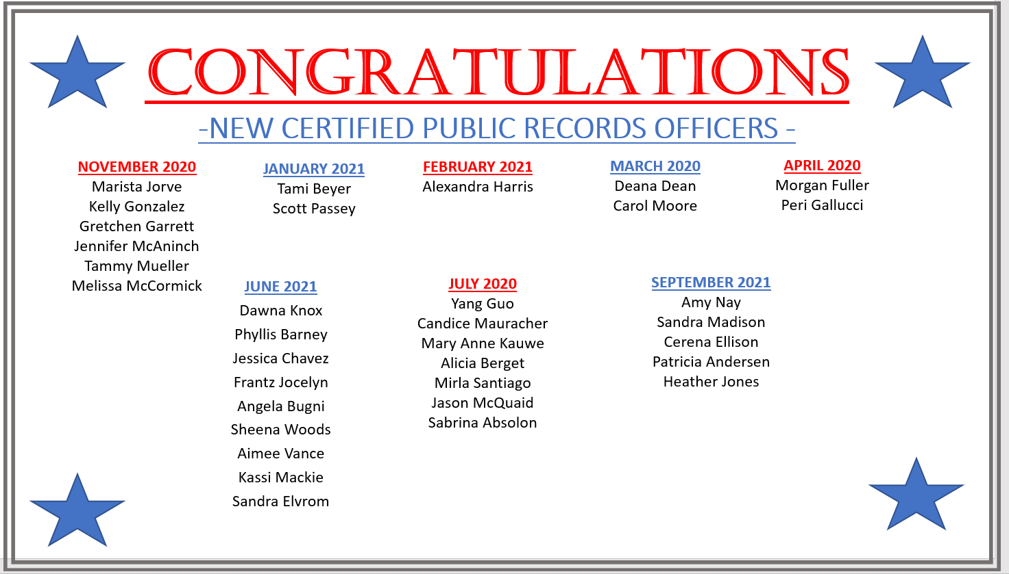

Slide 15


Slide 16
Welcome to the
WAPRO 2021 Virtual Fall Conference

Slide 17
Session 1A:
PRA as a Prelude to Litigation
8:00 am – 9:30 am
Ramsey Ramerman, City of Everett
Michele Earl Hubbard, Allied Law Group
Shannon Ragonesi, Keating, Bucklin &
McCormack, Inc., P.S.
Session 1A:
Dial In 1-253-215-8782
Webinar ID: 850 5914 4781
Passcode: 915501

Slide 18
Session 1B:
Case Law/Legal Update
9:45 am – 11:30 am
Ramsey Ramerman, City of Everett
Morgan Damerow, Attorney General’s Office
Sara Di Vittorio, Snohomish County PUD
Session 1B:
Dial In 1-253-215-8782
Webinar ID: 811 9748 3947
Passcode: 835749

Slide 19
Session 1C
Annual WAPRO Business Meeting
11:30 am – 12:00 pm
WAPRO Board
Session 1C:
Dial In 1-253-215-8782
Webinar ID: 88501116 9390
Passcode: 340566

Slide 20
THANK YOU!

